Slide 1






Slide 2
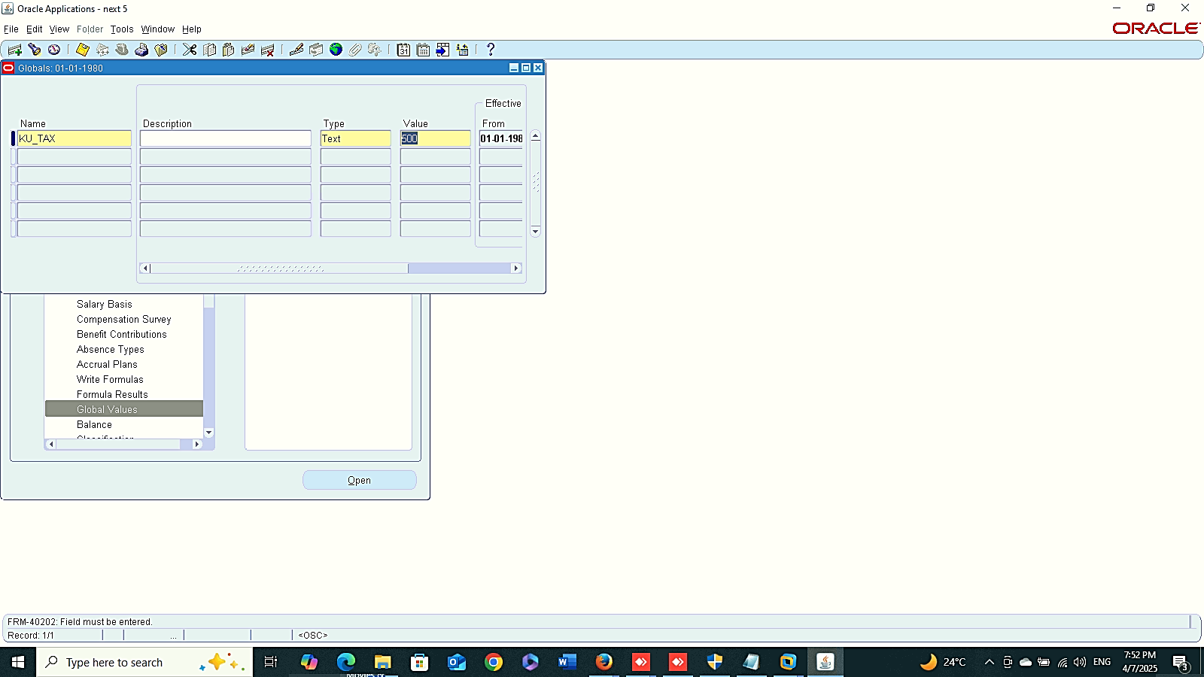
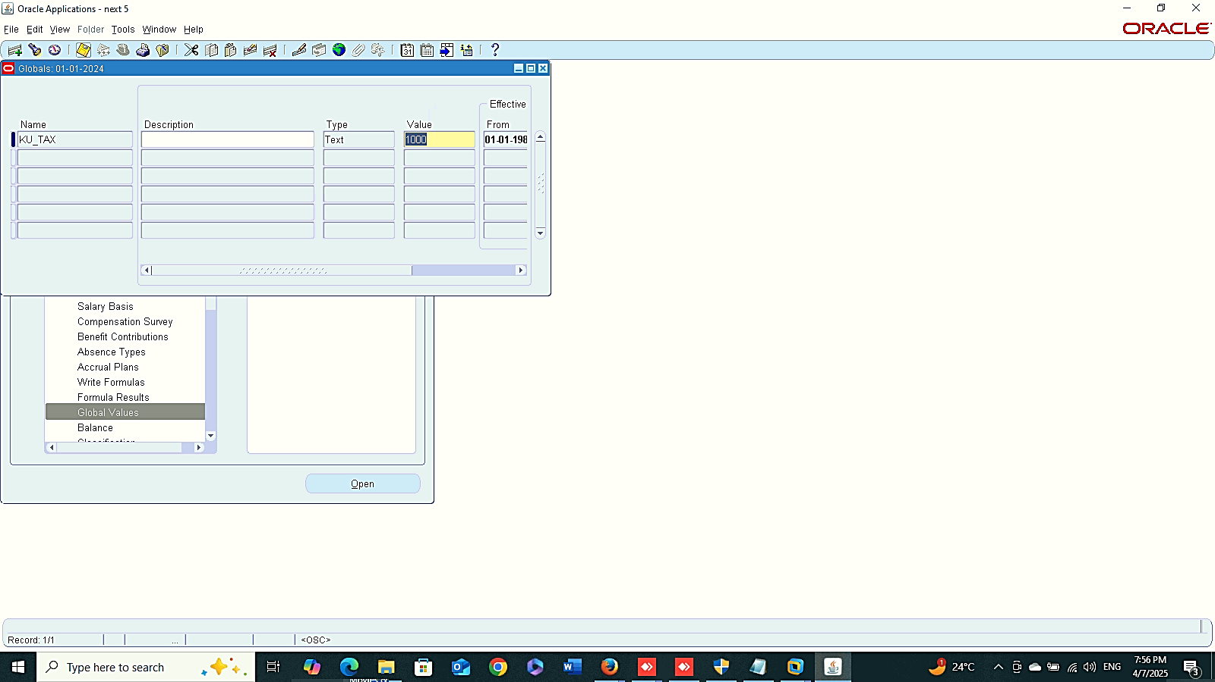
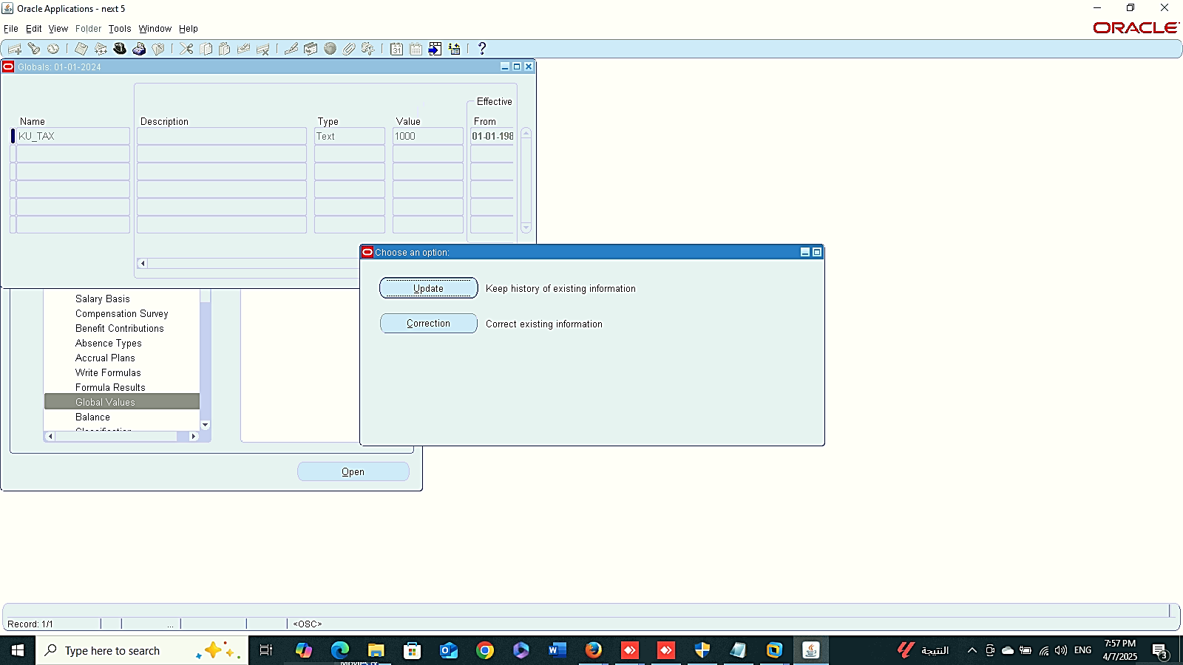
New Global Value
Finance Management (Payroll)
Global Value
GLOBAL HRMS MANAGER > TOTAL COMPENSATION > BASIC > BALANCE
Create New Global Value
Edit Global Value
1
Edit Global Value
2

Slide 3
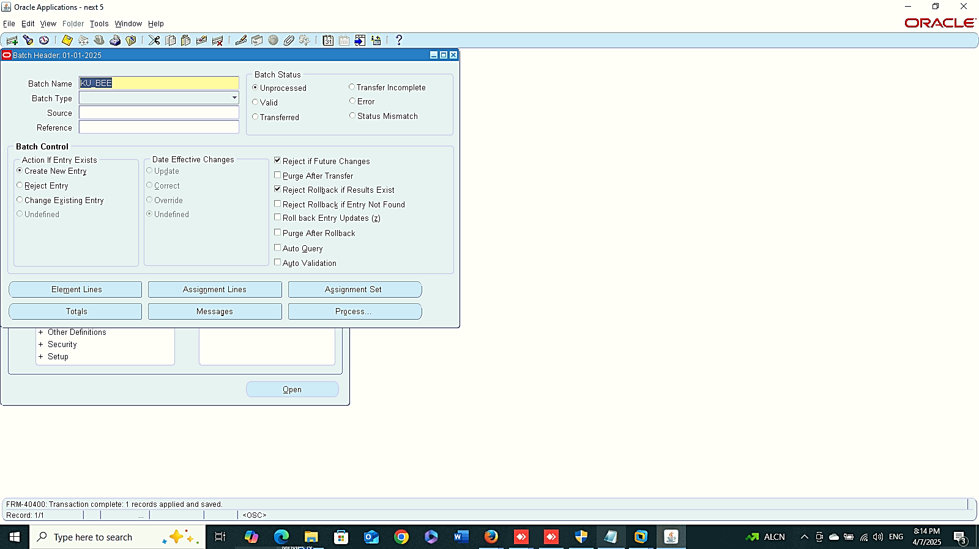
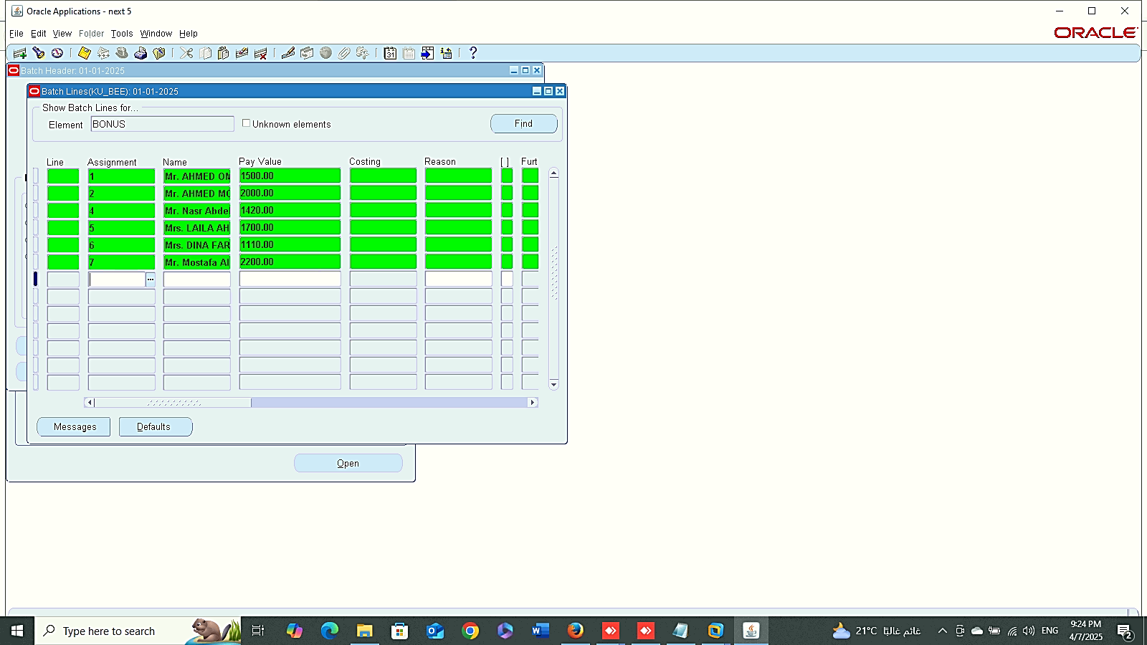
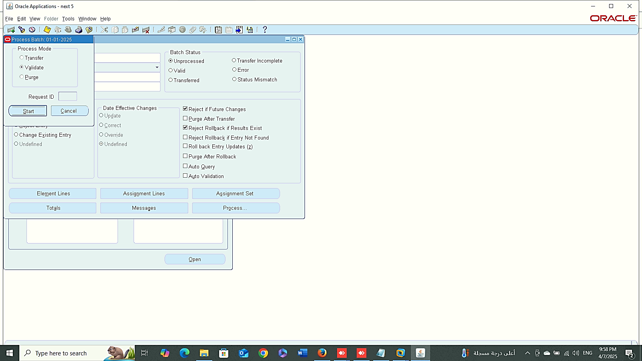
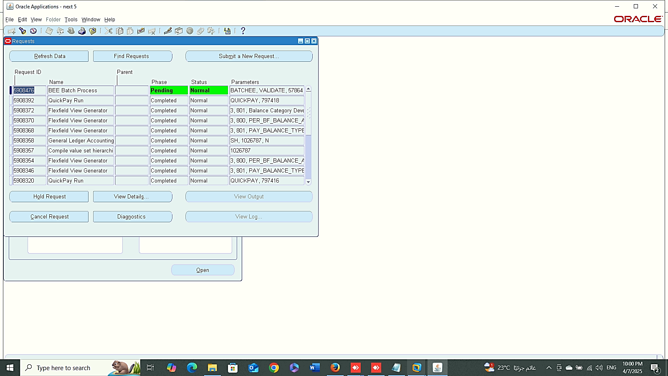
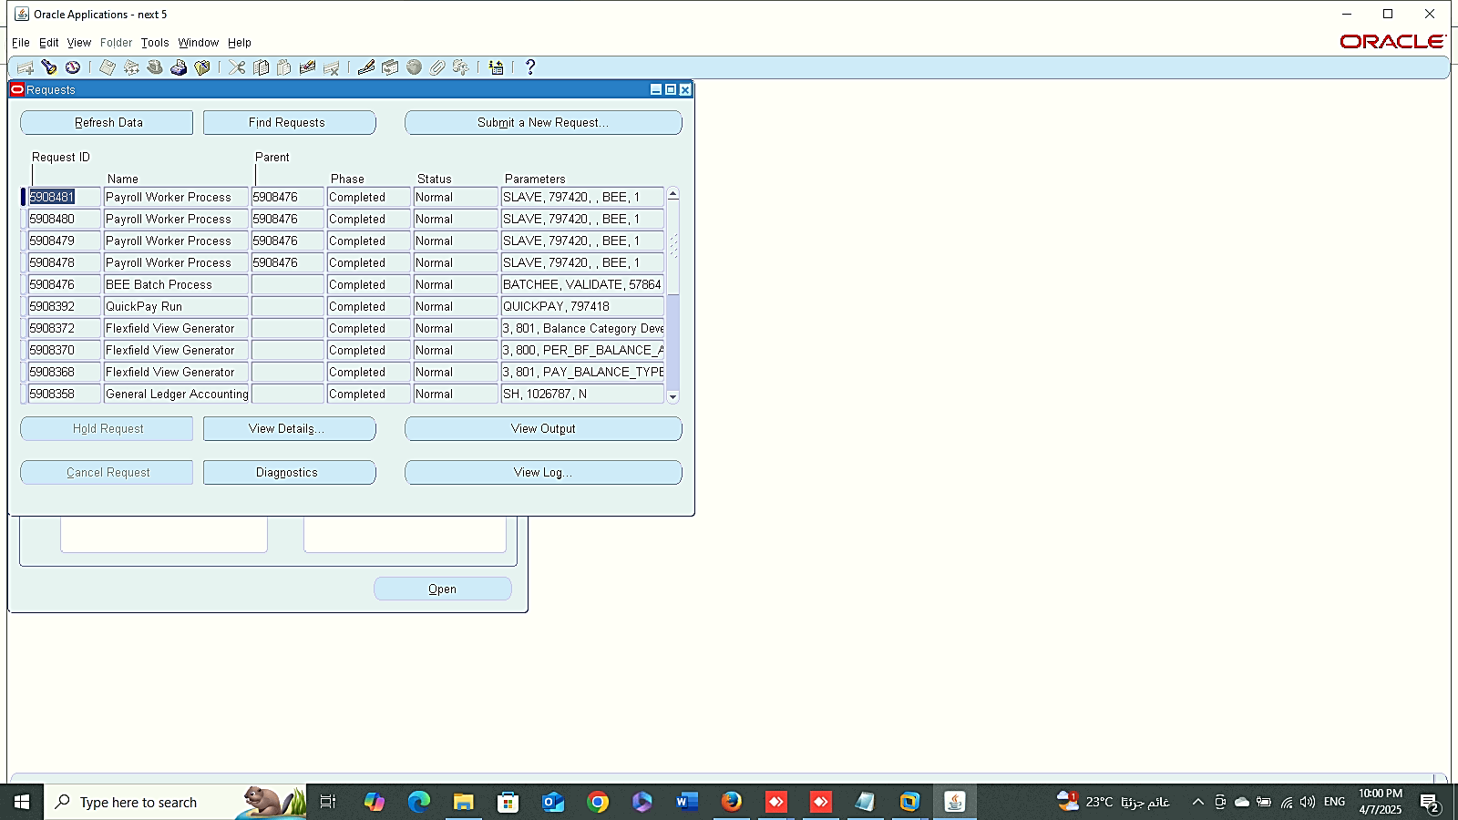
New BEE
Elements Lines
Finance Management (Payroll)
Batch Element Entry(BEE)
GLOBAL HRMS MANAGER > MASS INFORMATION> EXCHANGE MIX > BATCH ELEMENT ENTRY
Create New BEE
Elements Lines
Process
Process
1
1
Edit Global Value
2
3
2

Slide 4
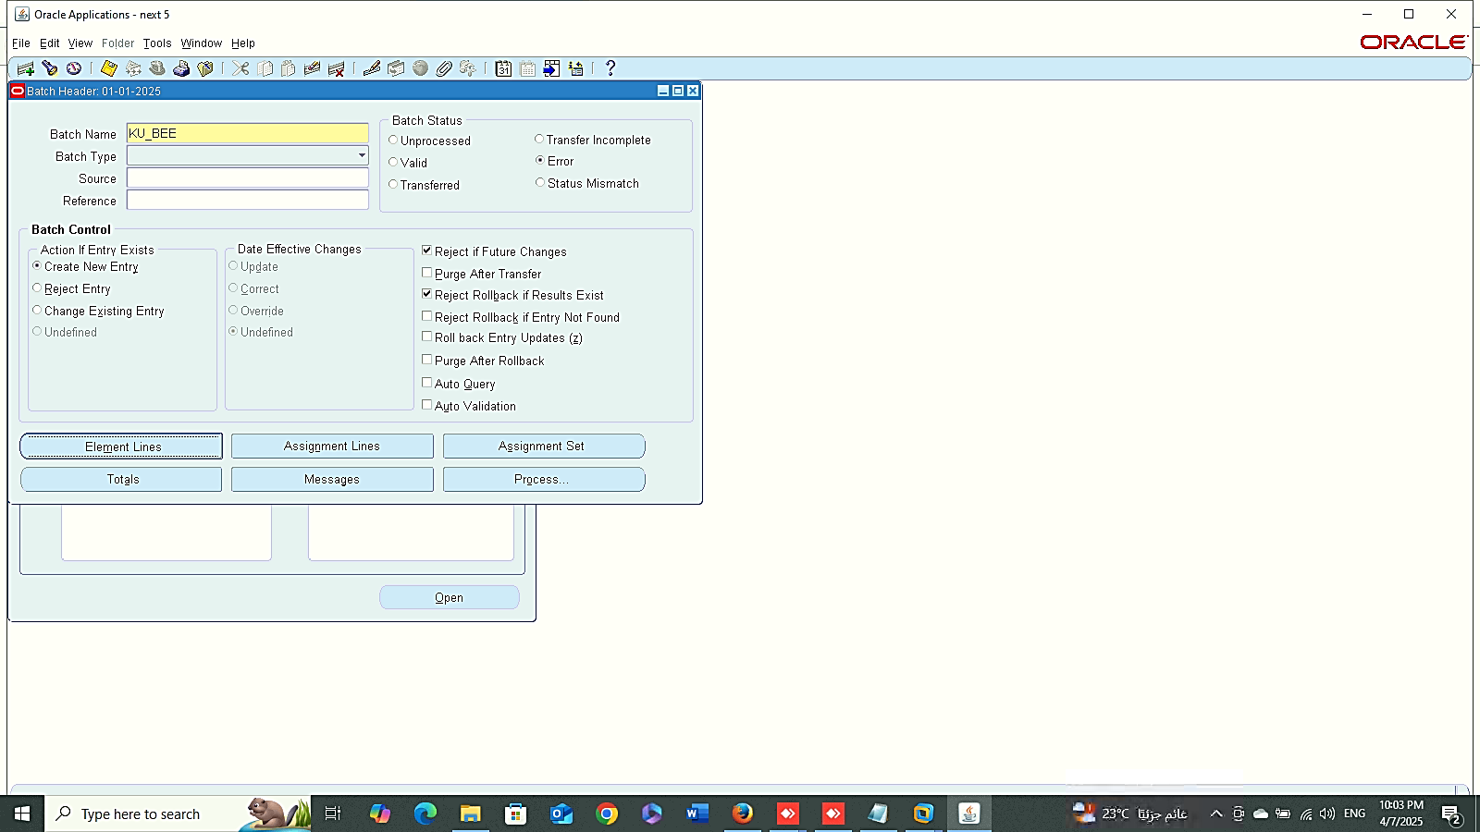
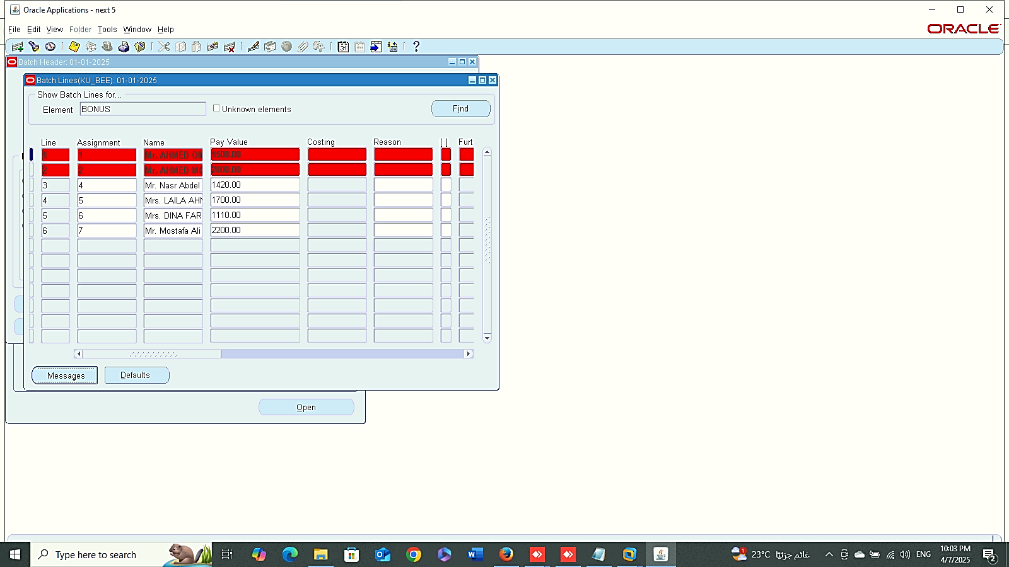
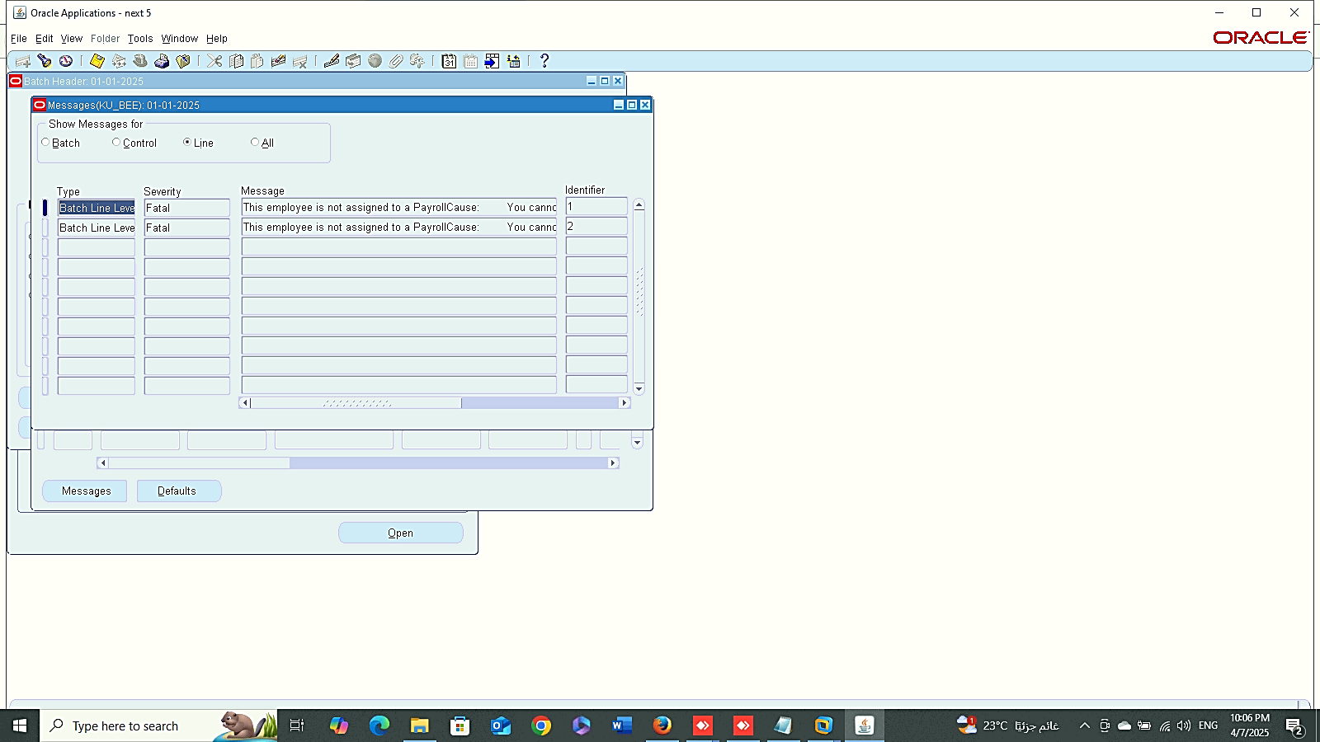
1
2
Finance Management (Payroll)
Batch Element Entry(BEE)
4. Errors
3

Slide 5
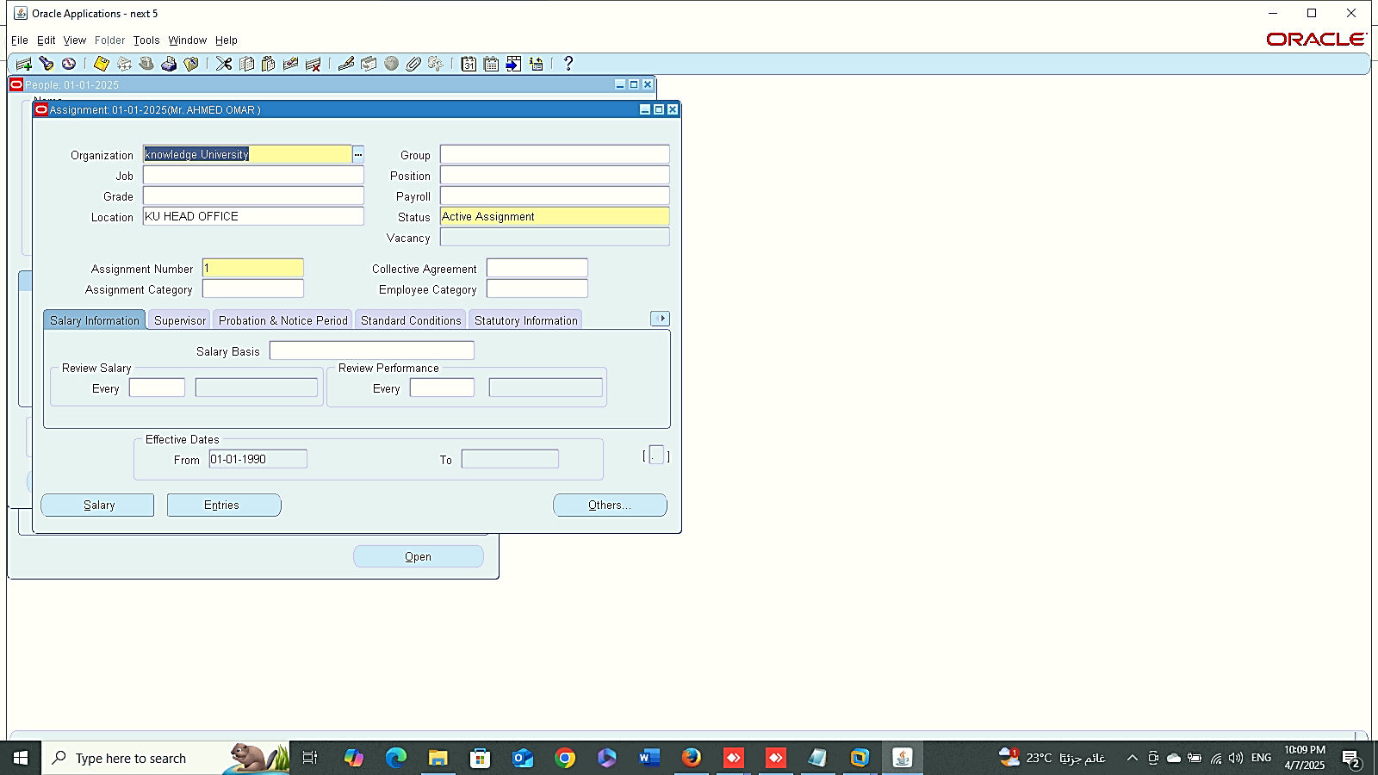
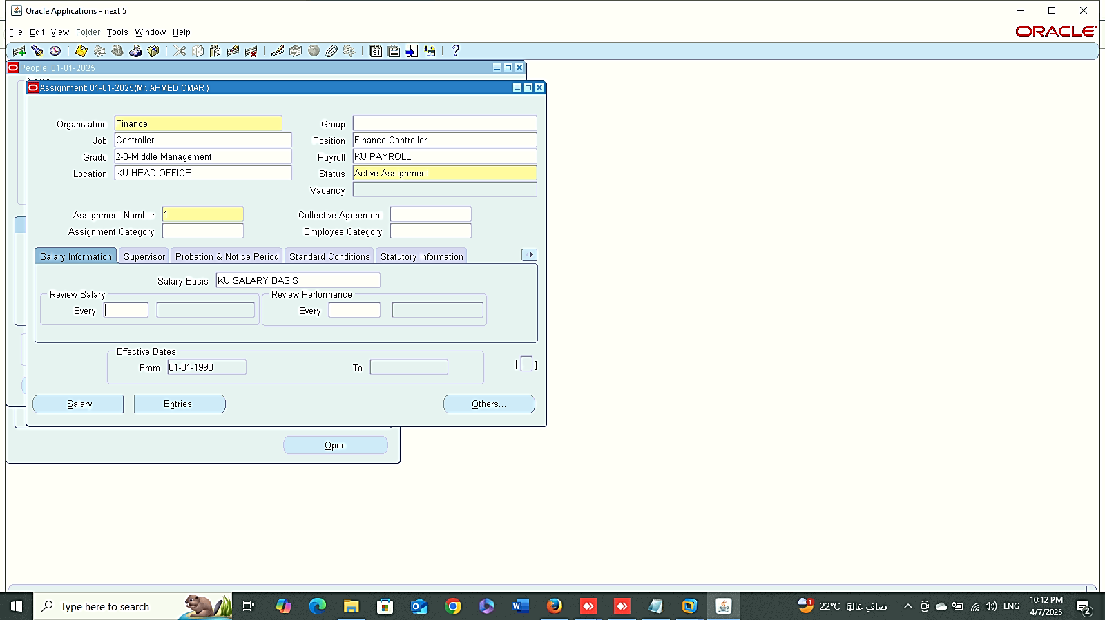
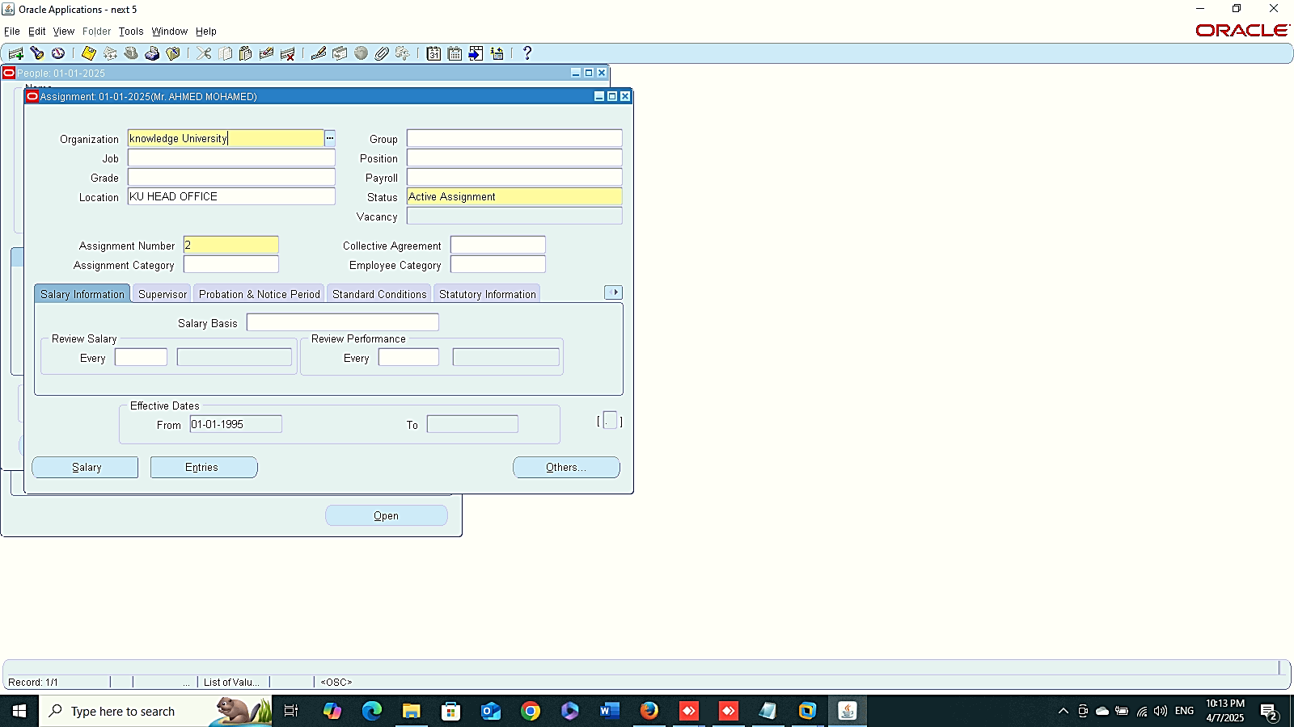
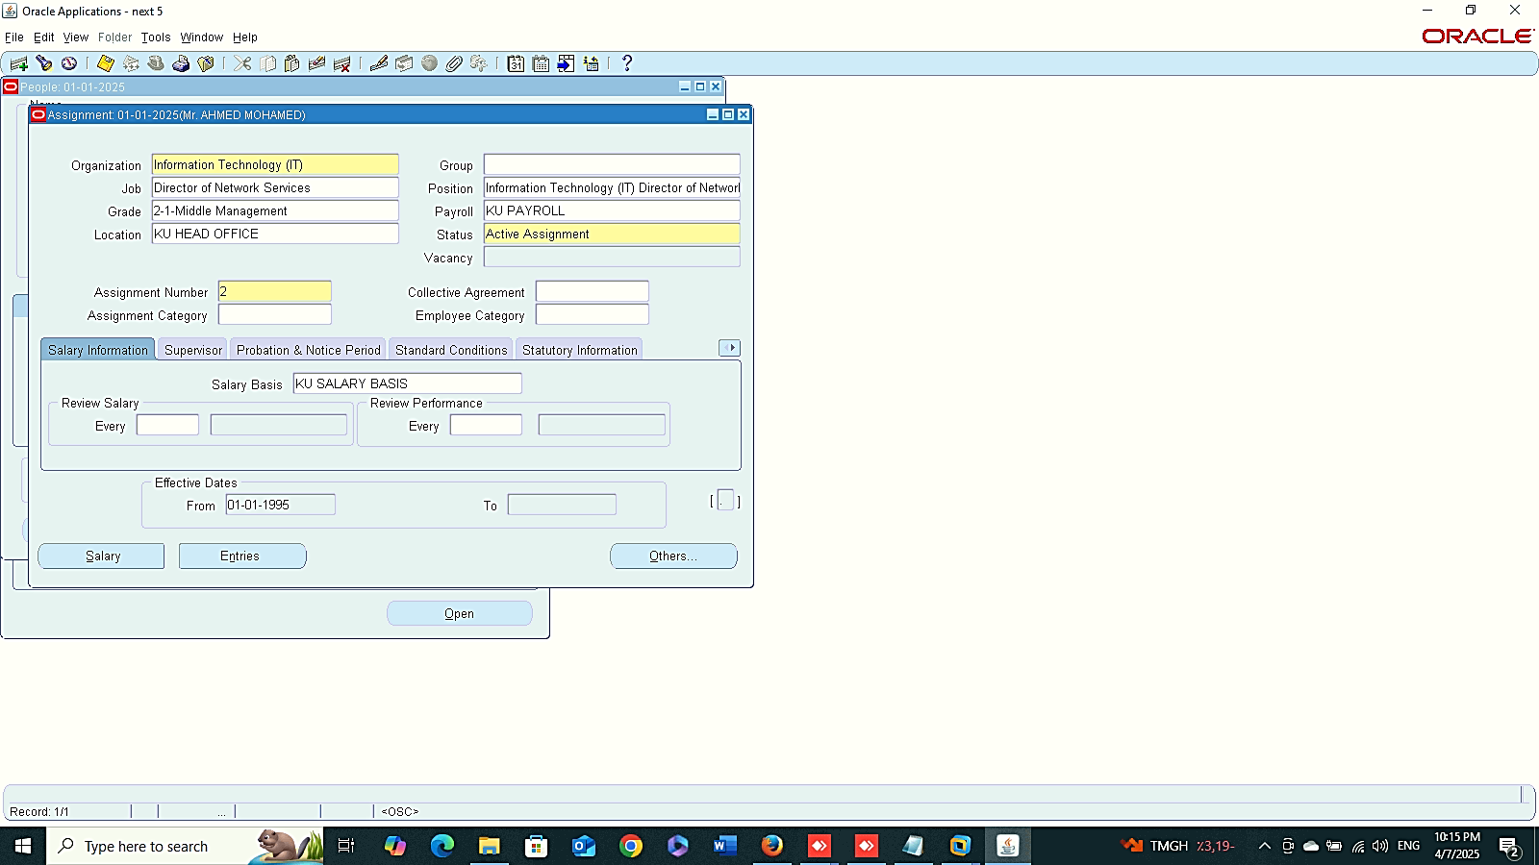
1
2
Finance Management (Payroll)
Add Payroll to Assignment Number 1&2
3
4

Slide 6
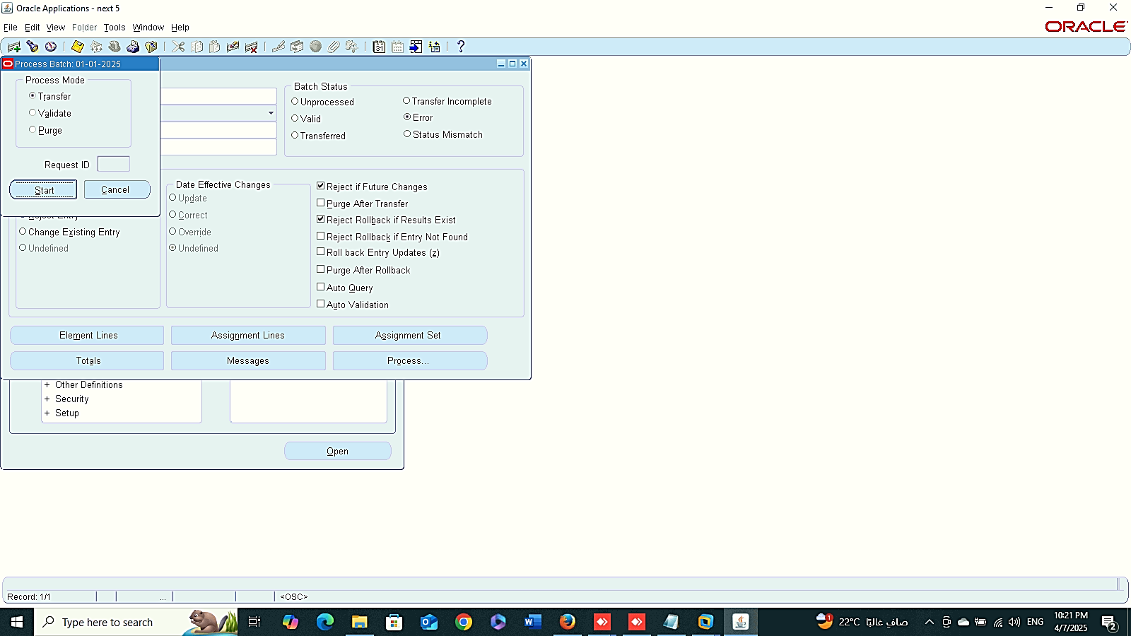
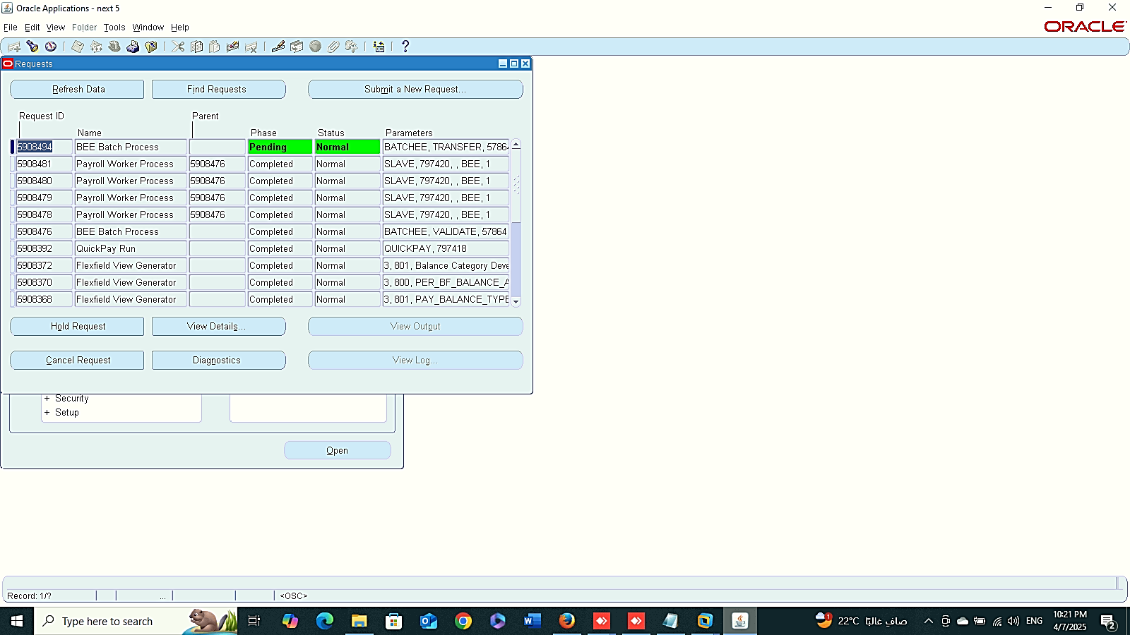
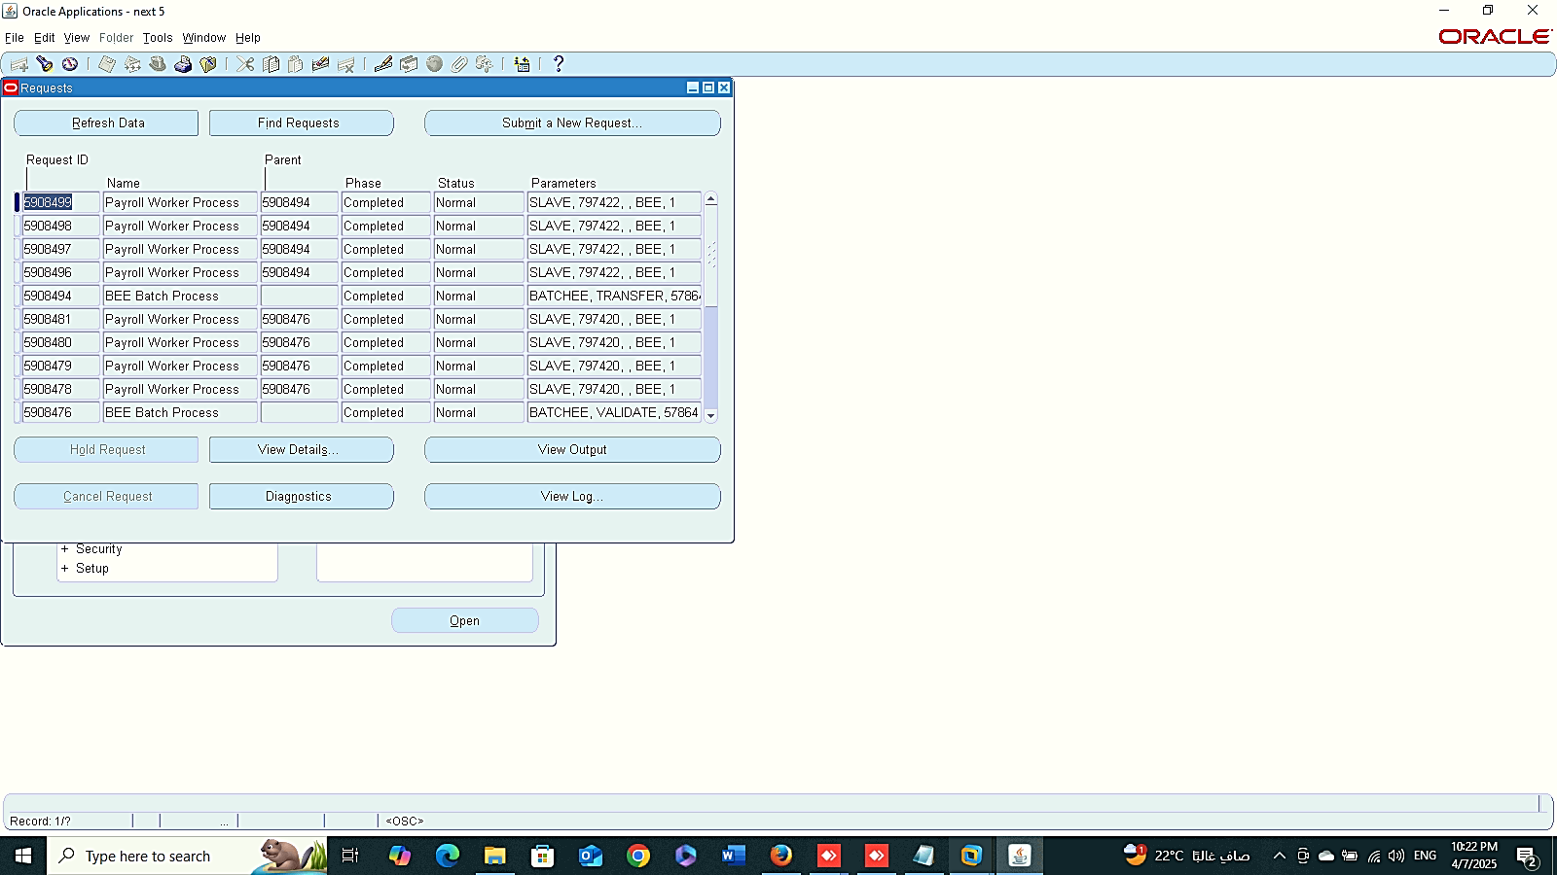
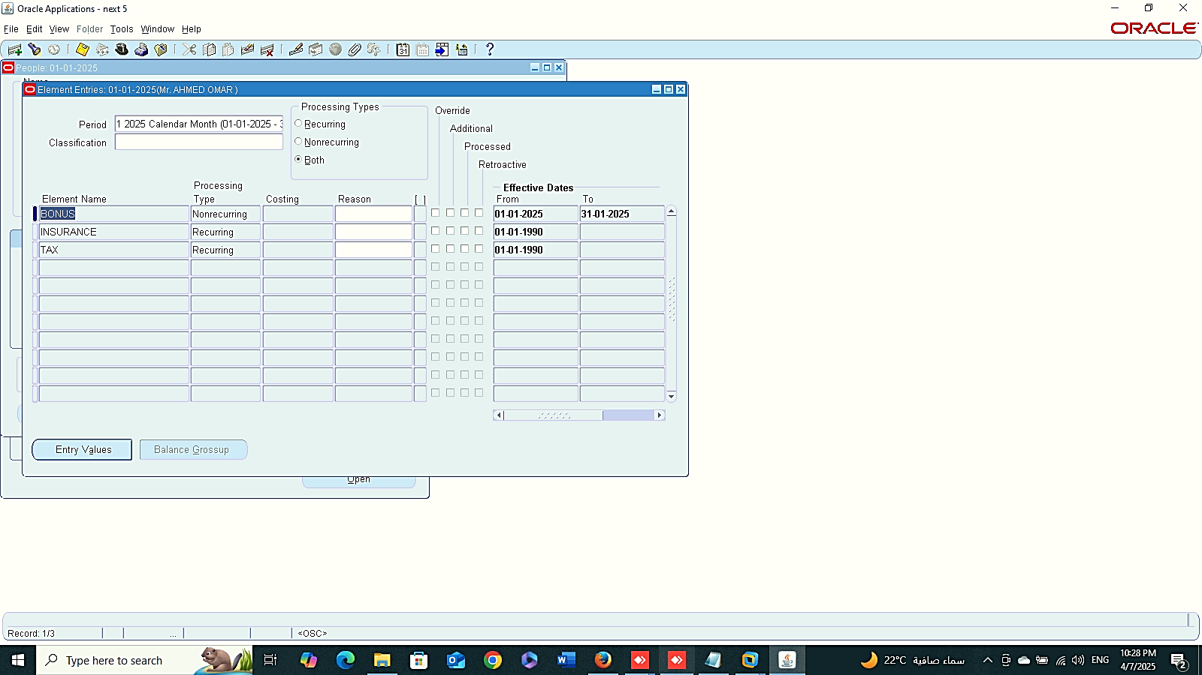
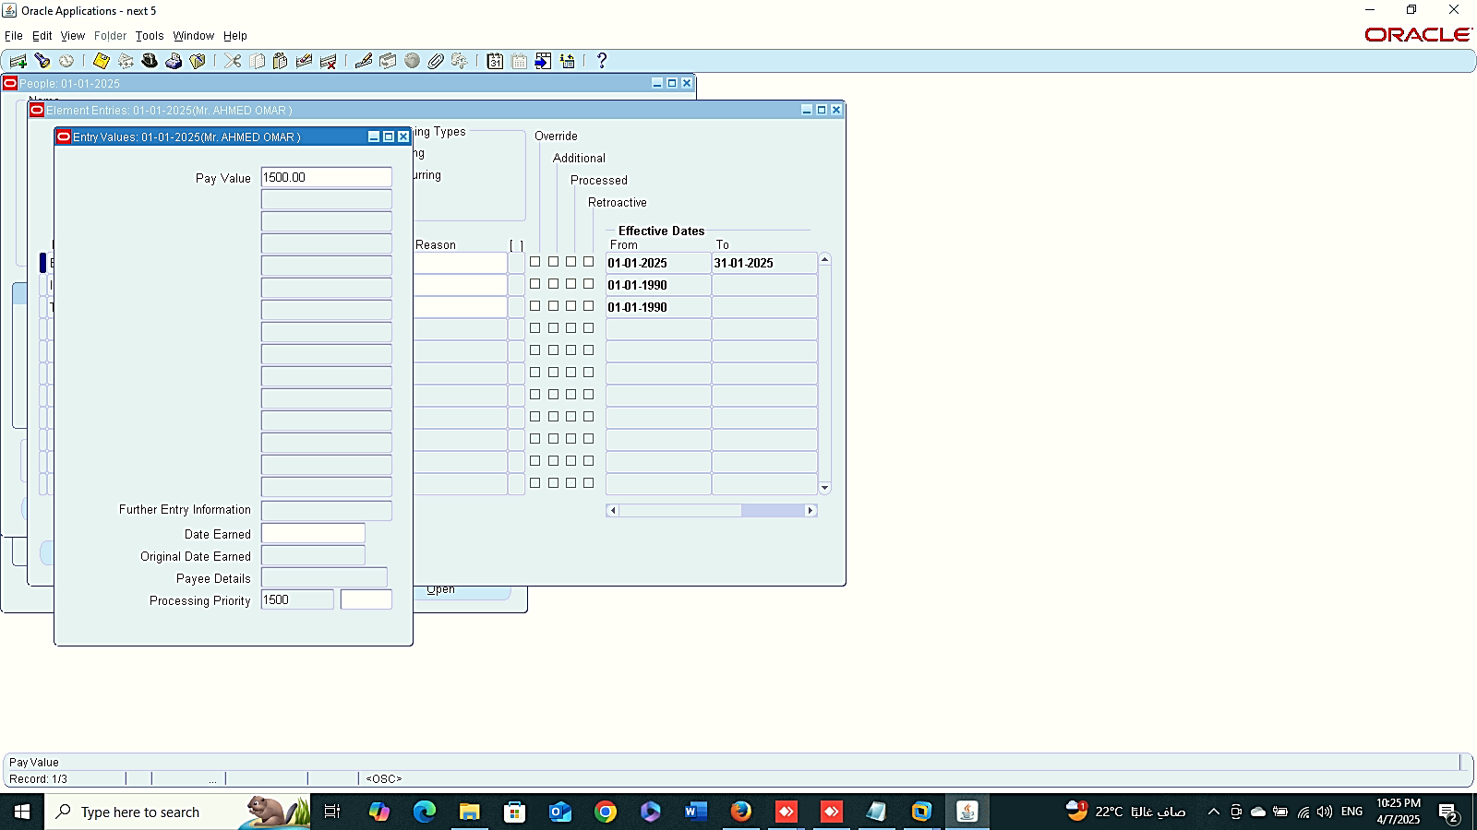
1
2
Finance Management (Payroll)
Process
3
4
5

Slide 7
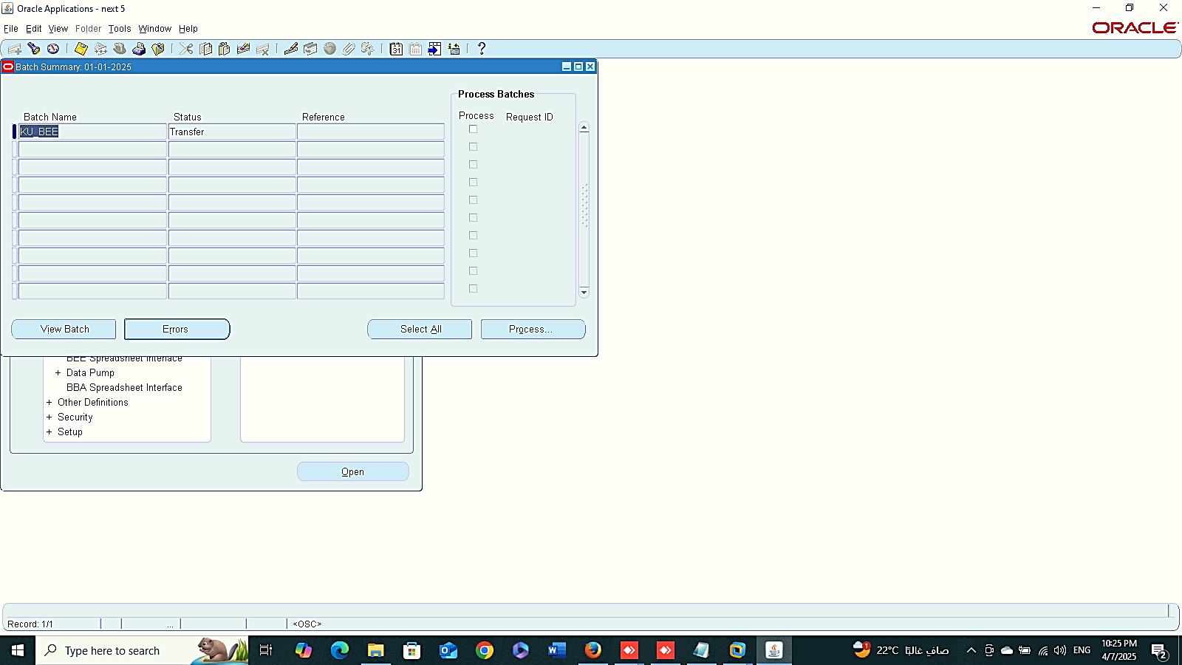
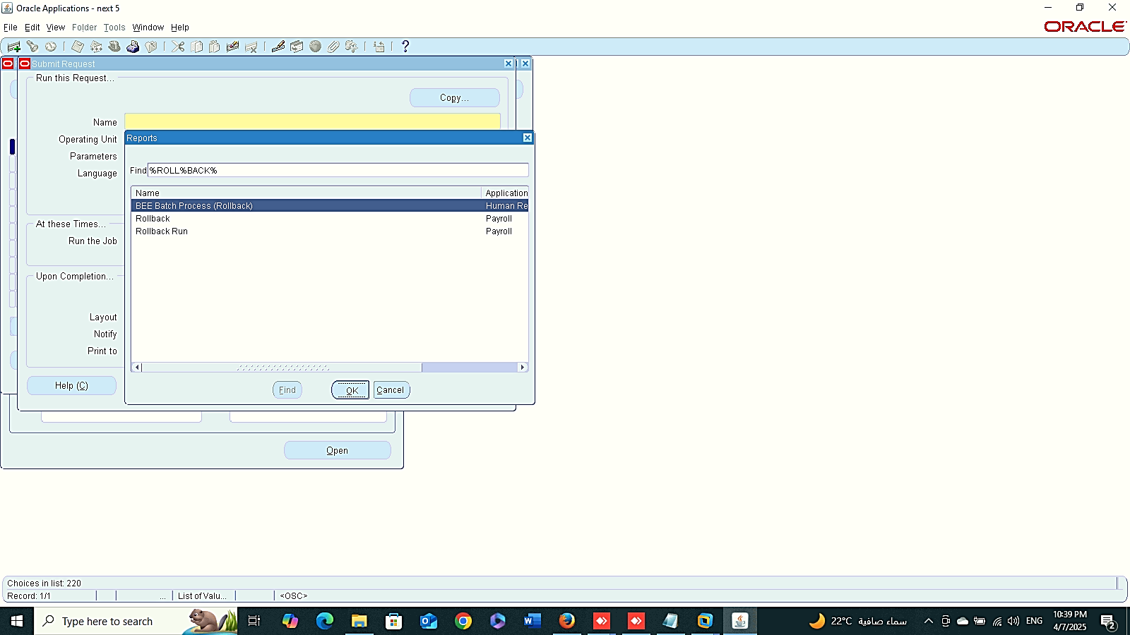
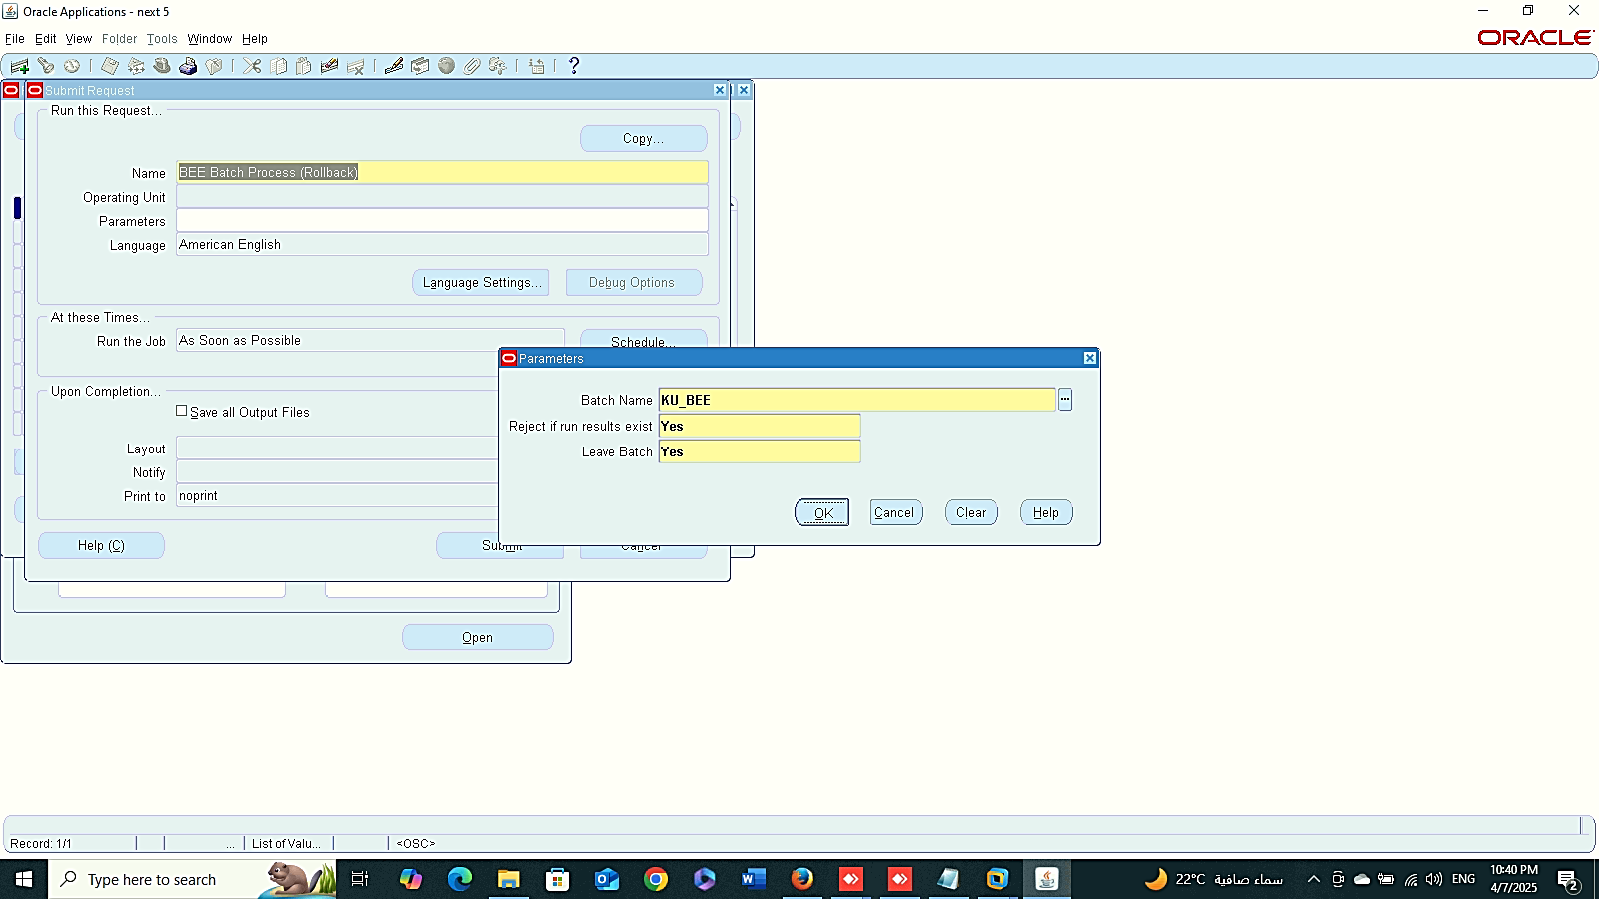
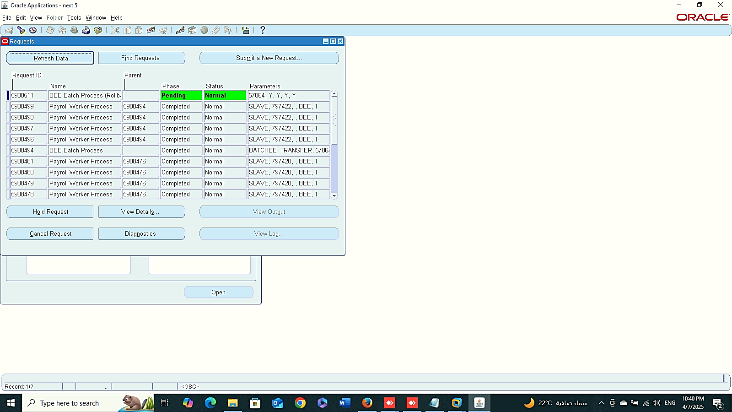
Batch Summary
Boll Back
1
Finance Management (Payroll)
Batch Summary
GLOBAL HRMS MANAGER > MASS INFORMATION> EXCHANGE MIX > BATCH SUMMARY
Roll Back
GLOBAL HRMS MANAGER > REQUESTS> SUBMIT A NEW REQUEST
2
3

Slide 8

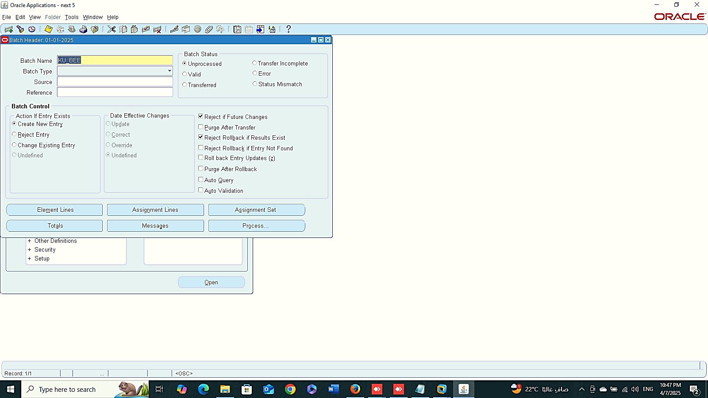
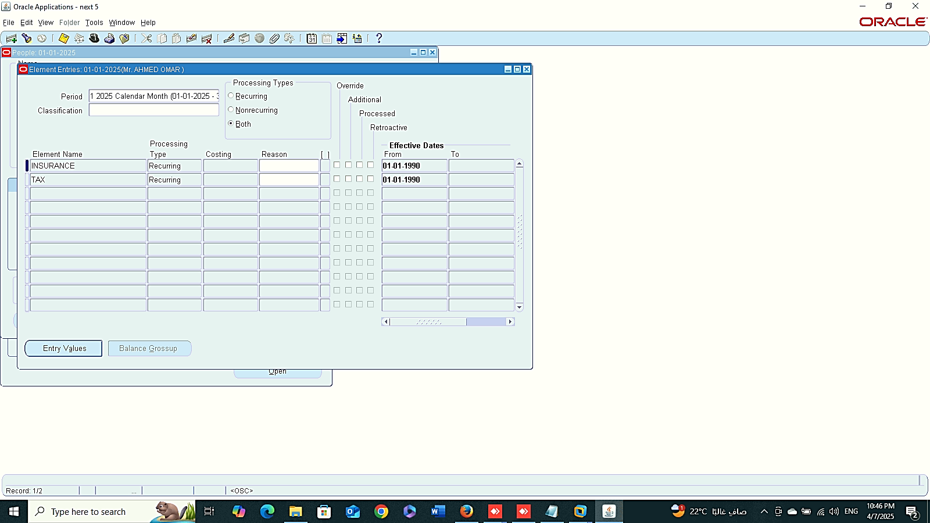


5
6
Finance Management (Payroll)
Roll Back
GLOBAL HRMS MANAGER > REQUESTS> SUBMIT A NEW REQUEST
7
8
9

Slide 9
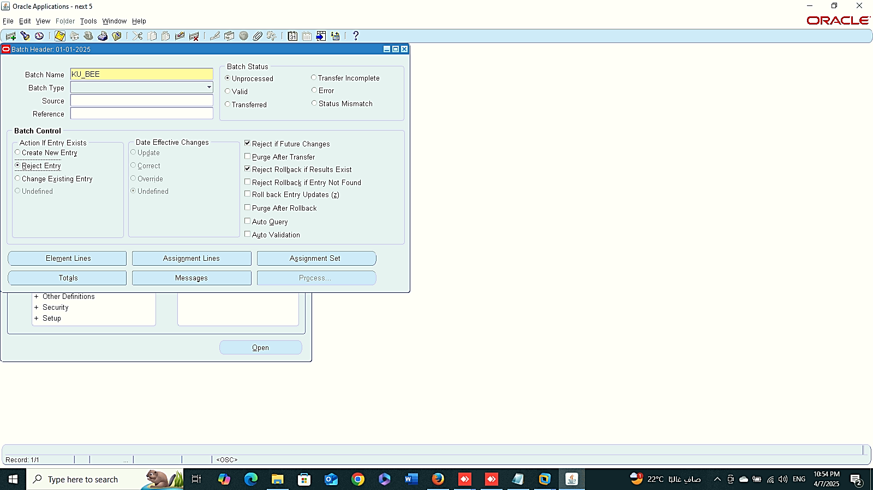
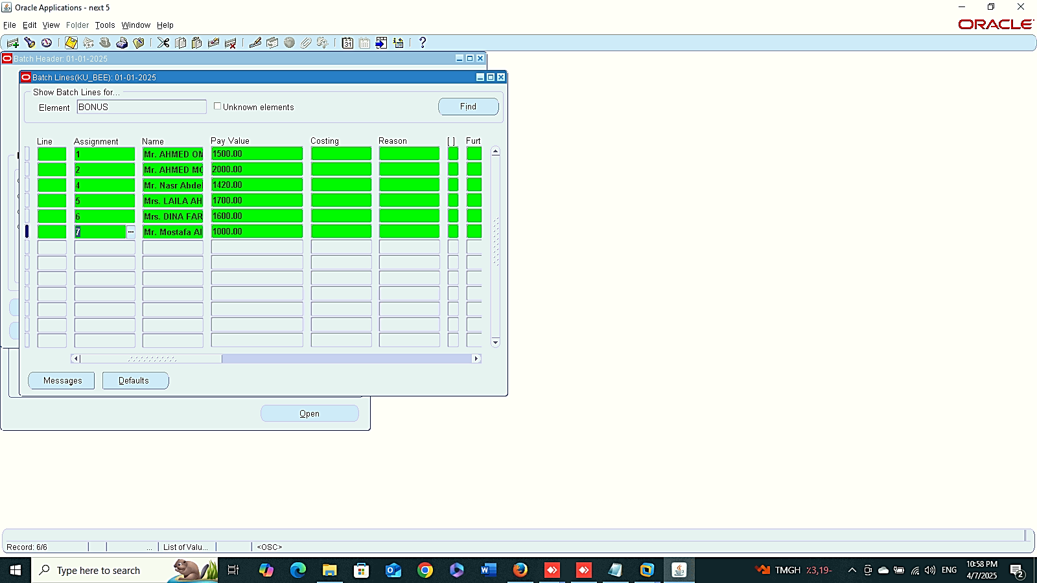

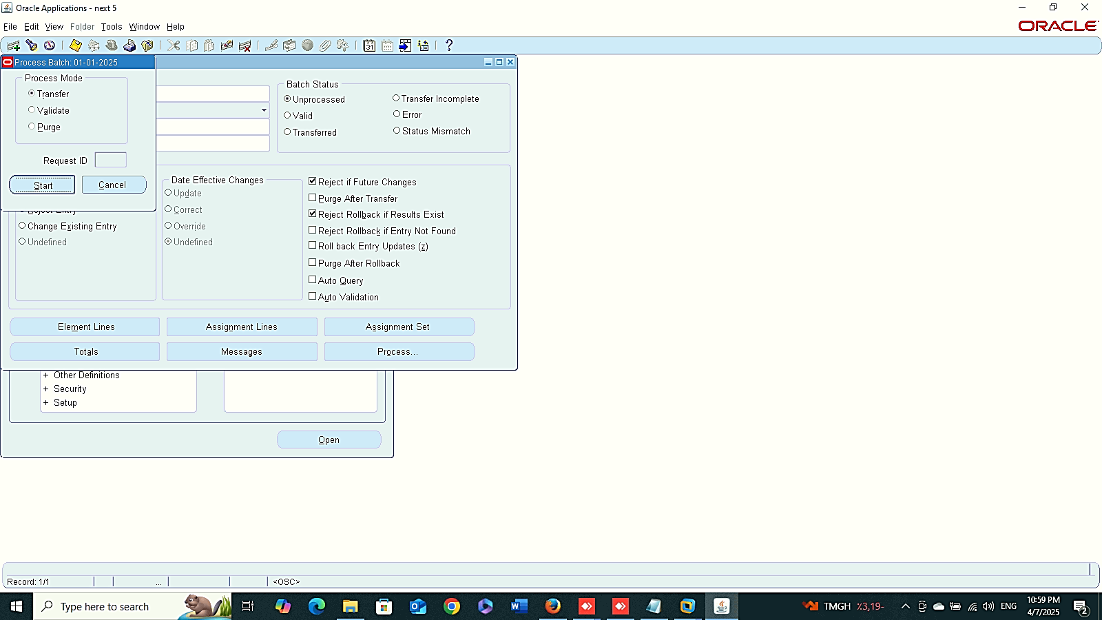

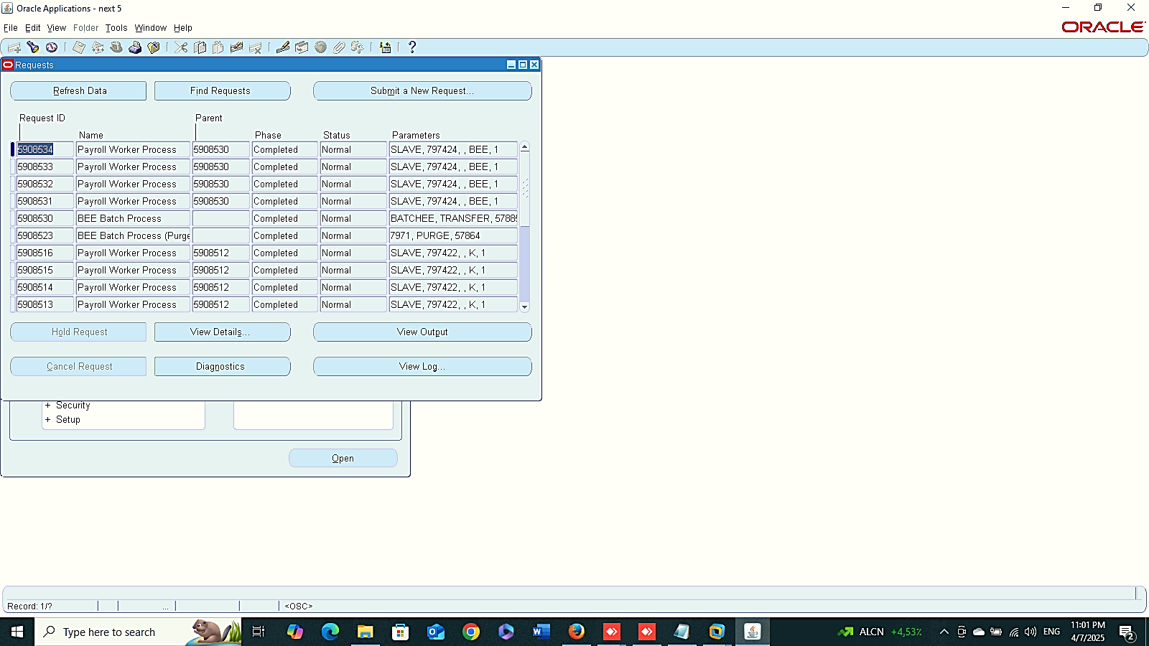
1
2
3
Finance Management (Payroll)
Create New BEE
Reject Entry
4
5
6

Slide 10

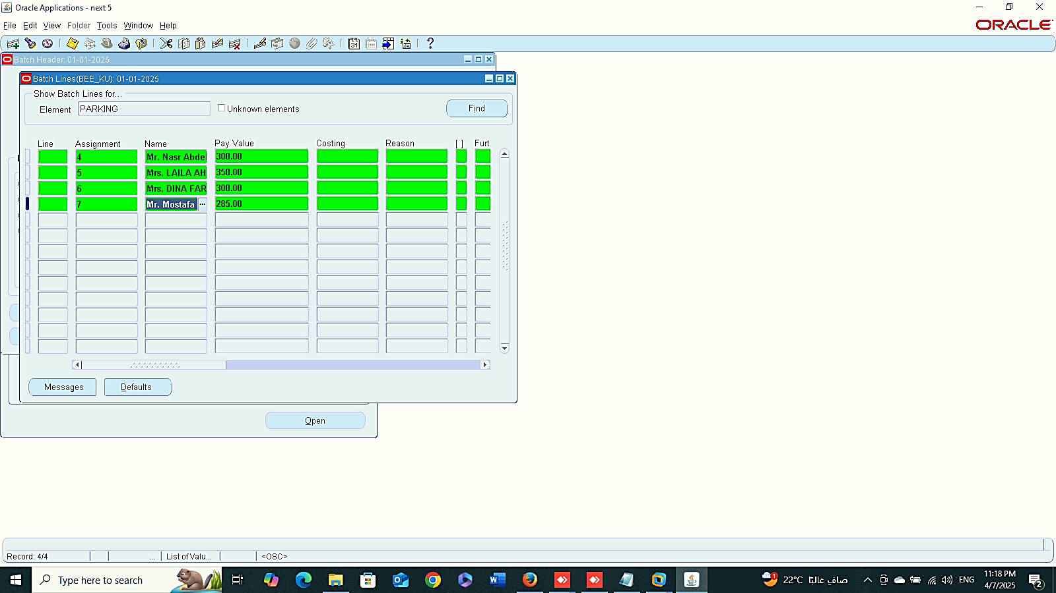
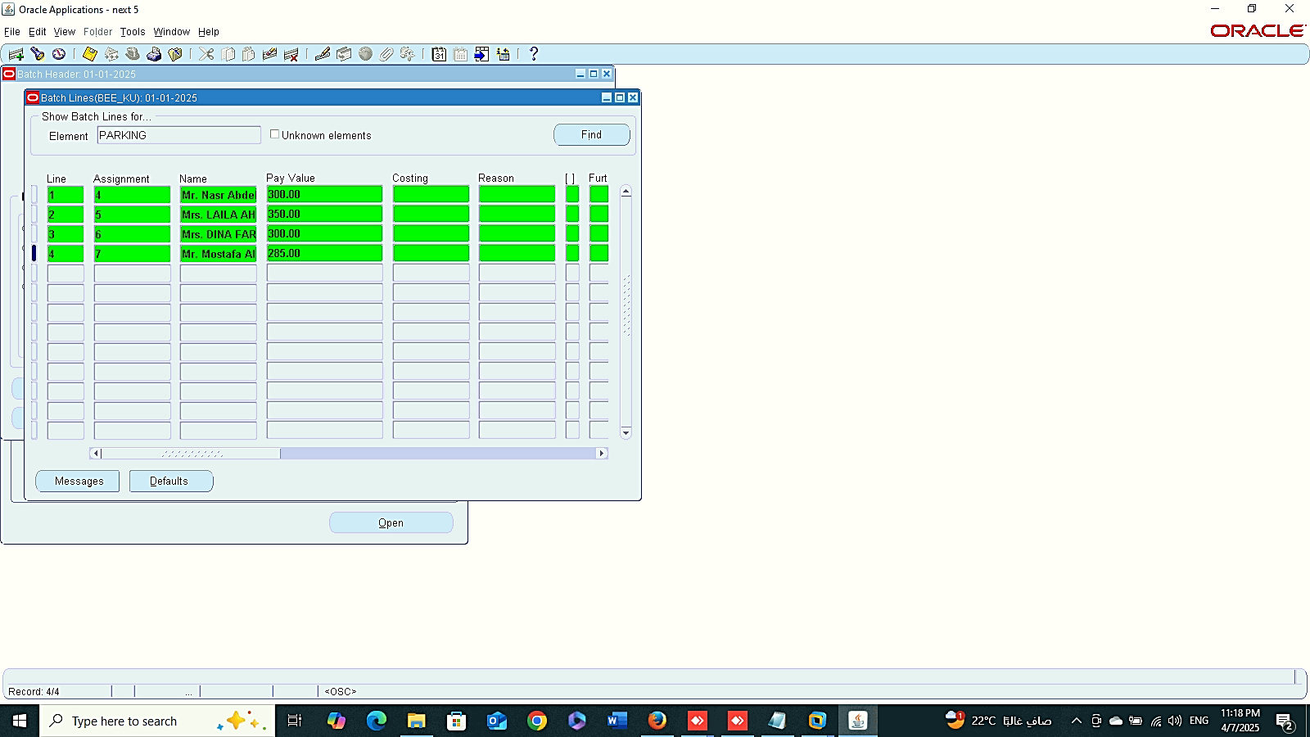
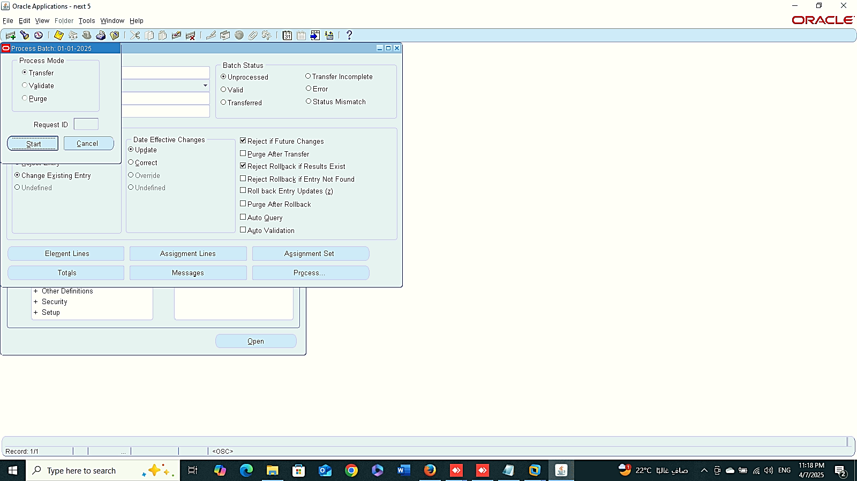
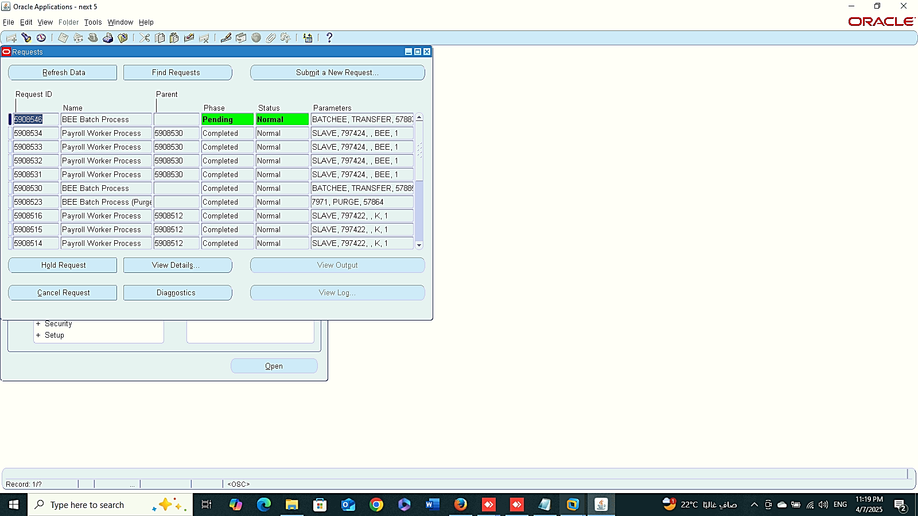
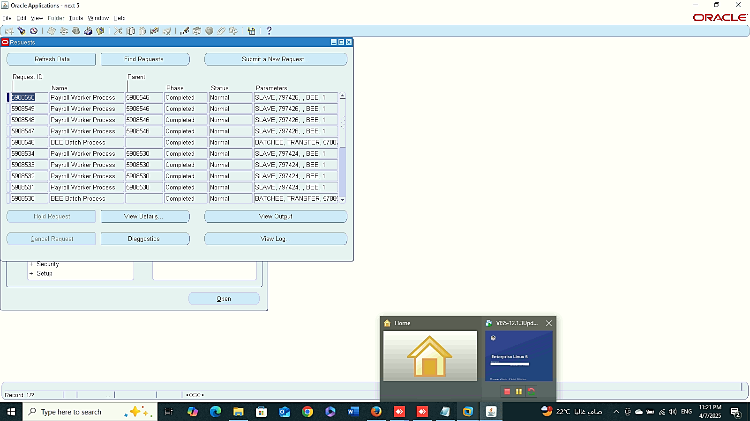
1
2
3
Finance Management (Payroll)
Create New BEE
Change Existing Entry
(BEE_KU)
4
5
6

Slide 11
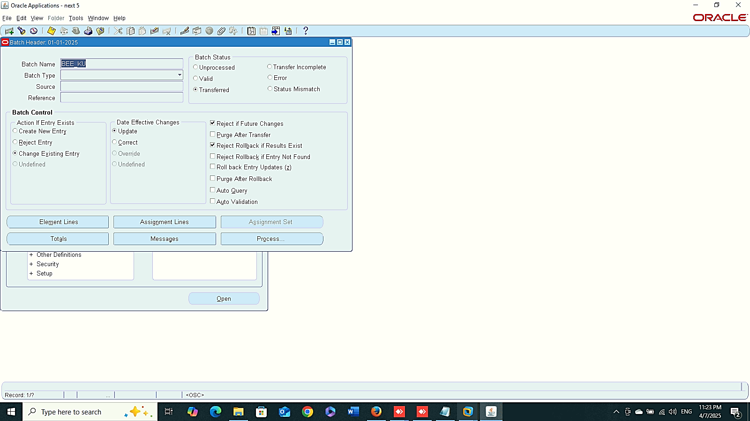
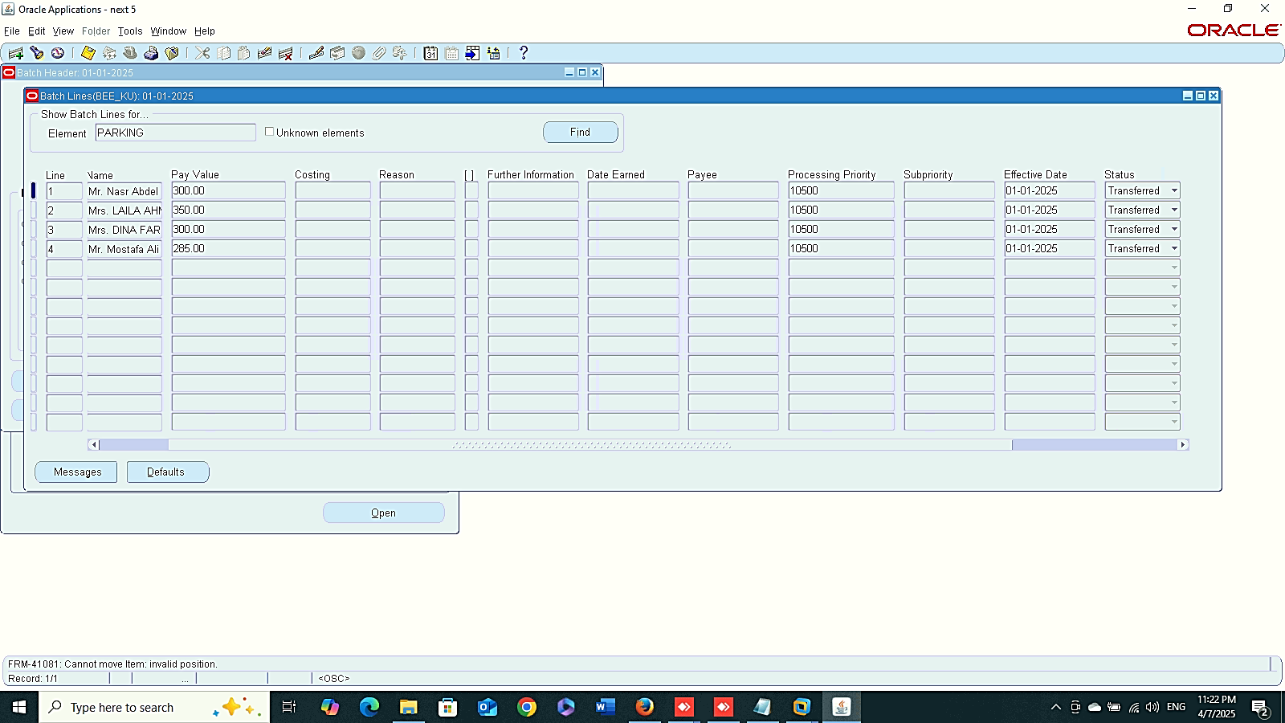
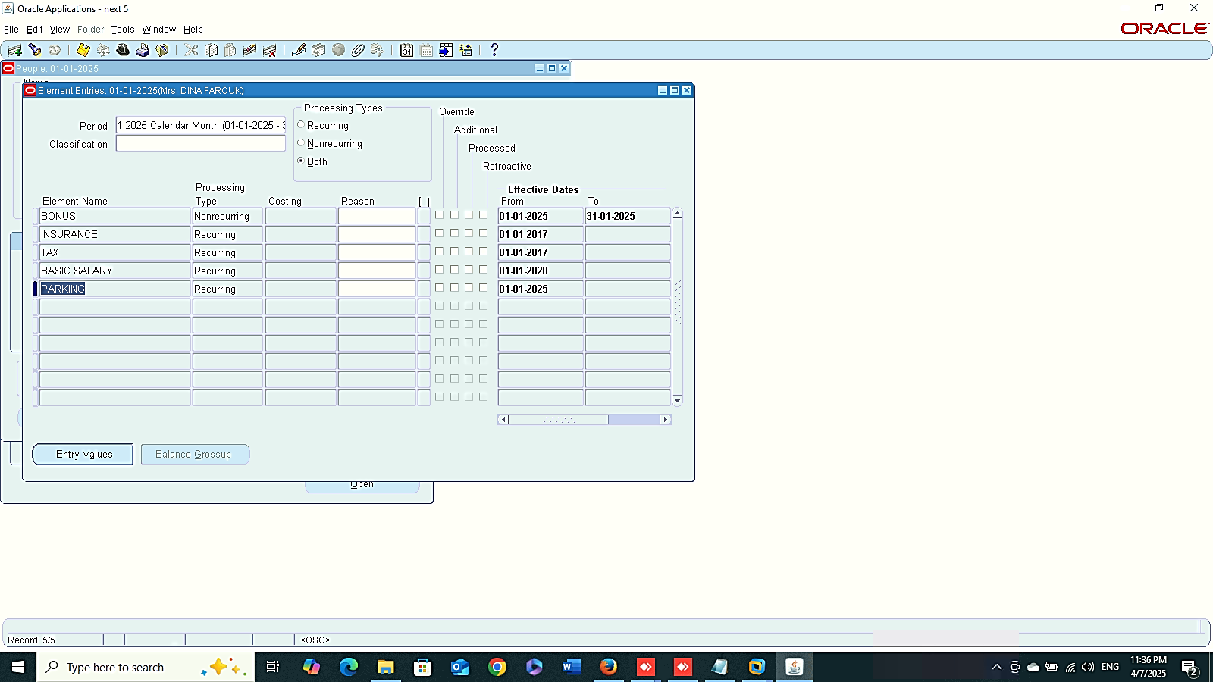
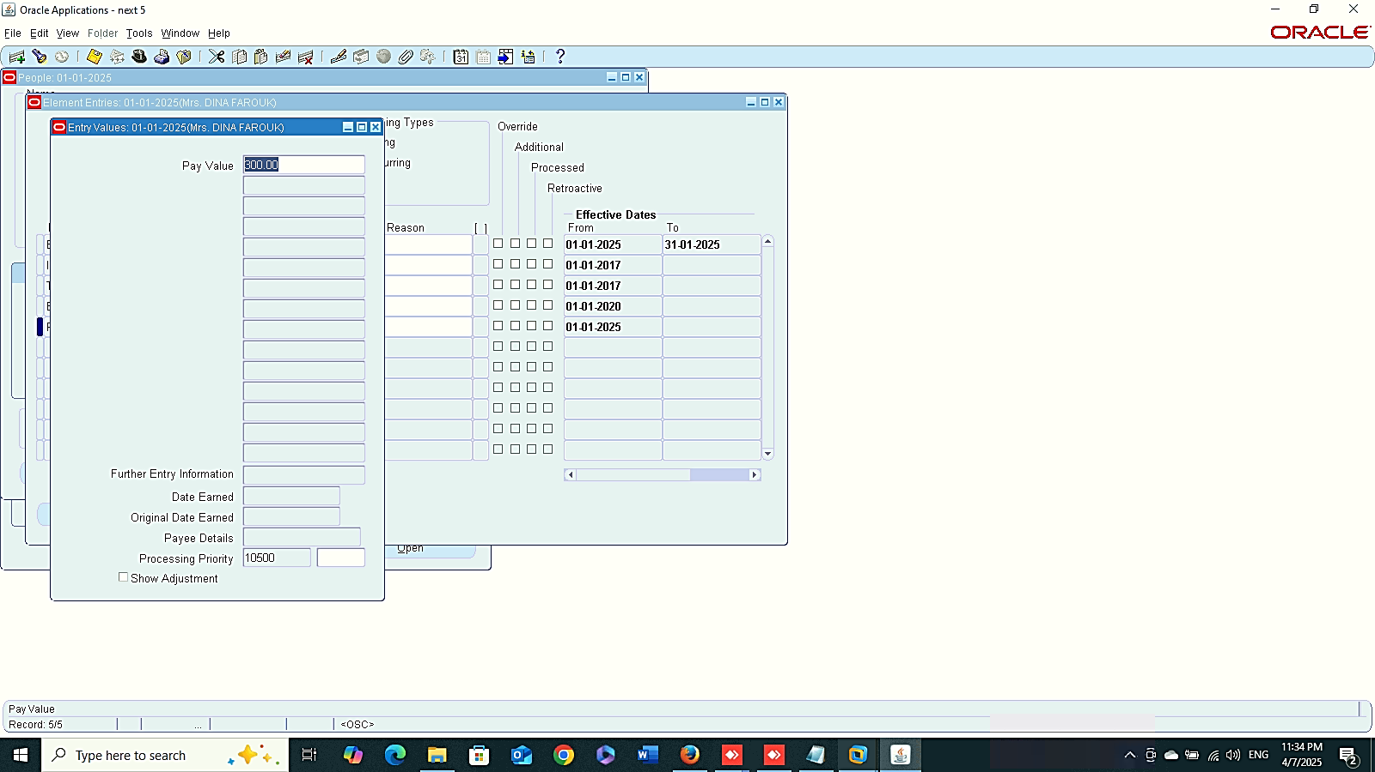
1
2
Finance Management (Payroll)
Create New BEE
Change Existing Entry
(BEE_KU)
3
4

Slide 12
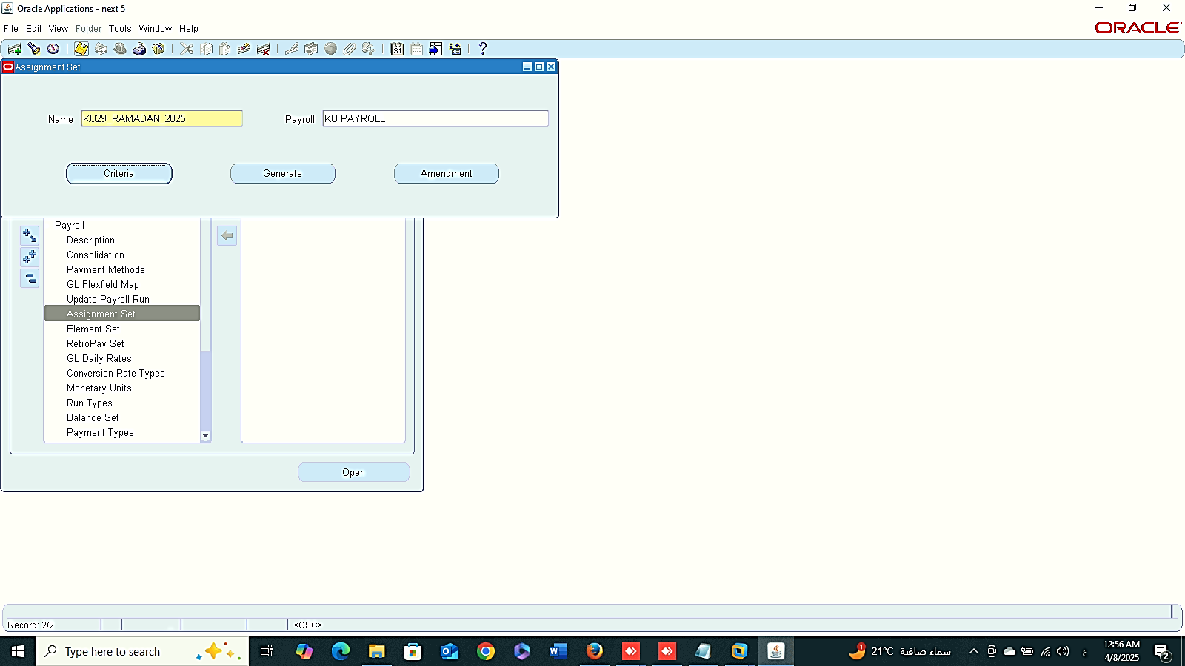
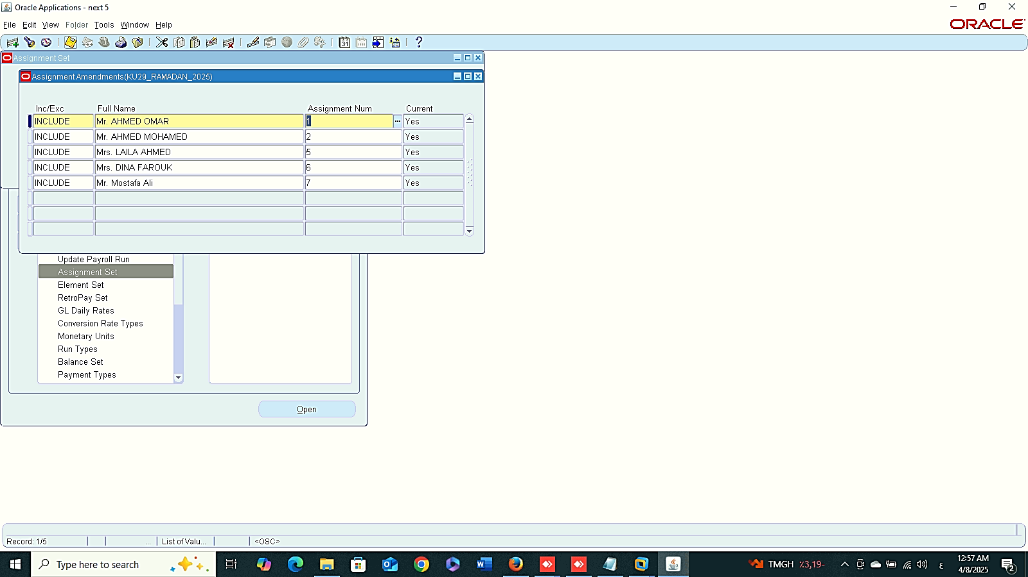
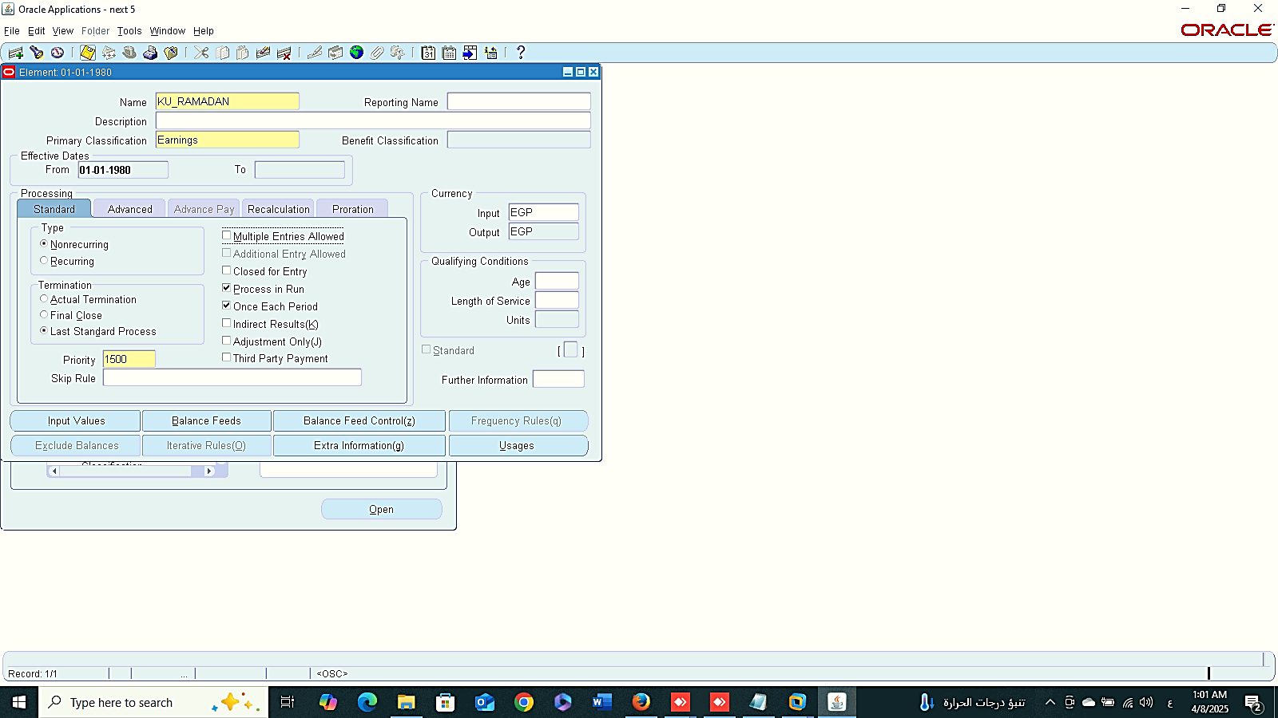
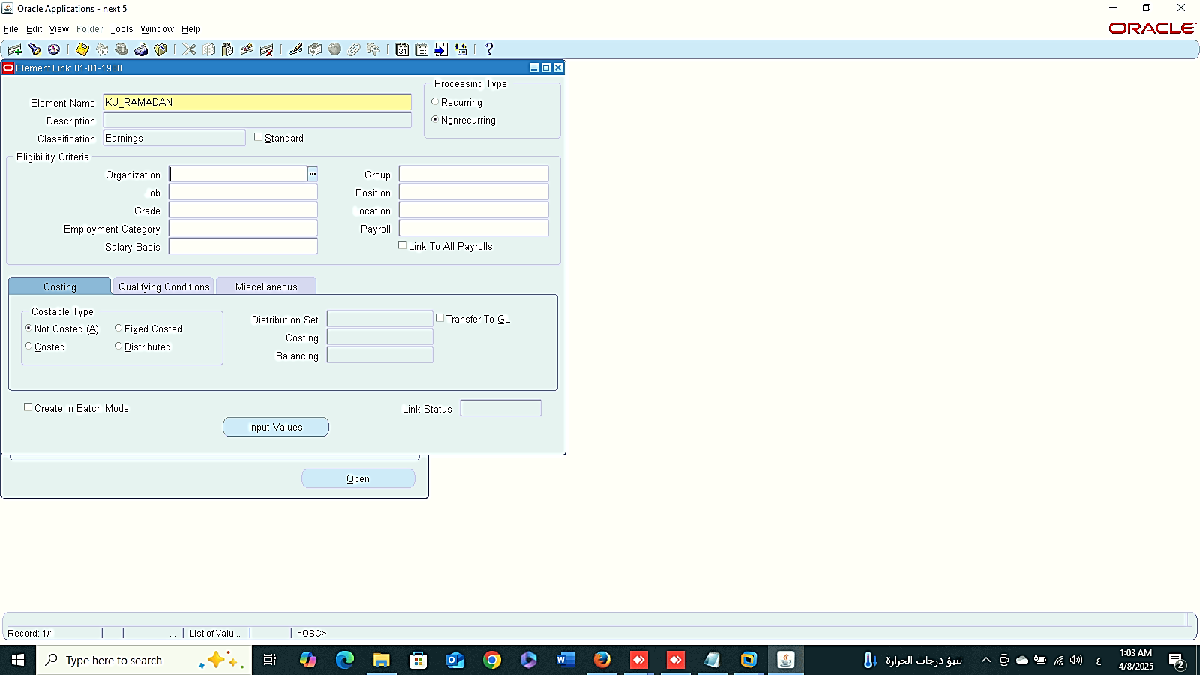
Add Employees
Finance Management (Payroll)
Assignment Set
GLOBAL HRMS MANAGER > PAYROLL > ASSIGNMENT SET
1- Add Employees to Assignment Set
2- Create New Elements:
GLOBAL HRMS MANAGER > TOTAL COMPENSATION > BASIC > ELEMENT DESCRIPTION
3- Create New Link :
GLOBAL HRMS MANAGER > TOTAL COMPENSATION > BASIC > LINK
New Elements
New Link

Slide 13
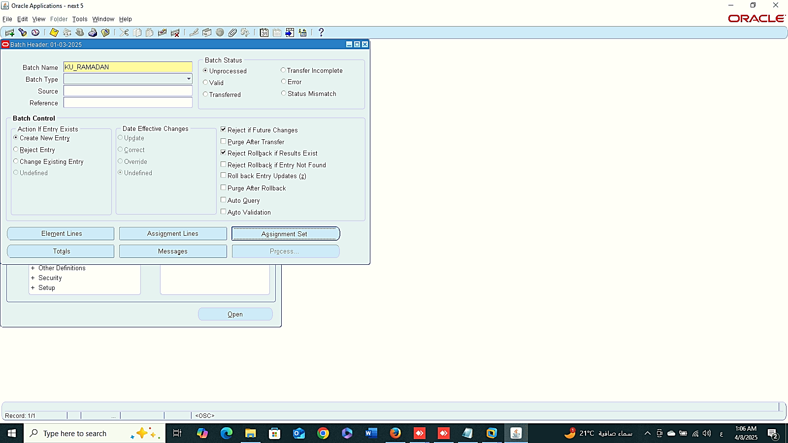
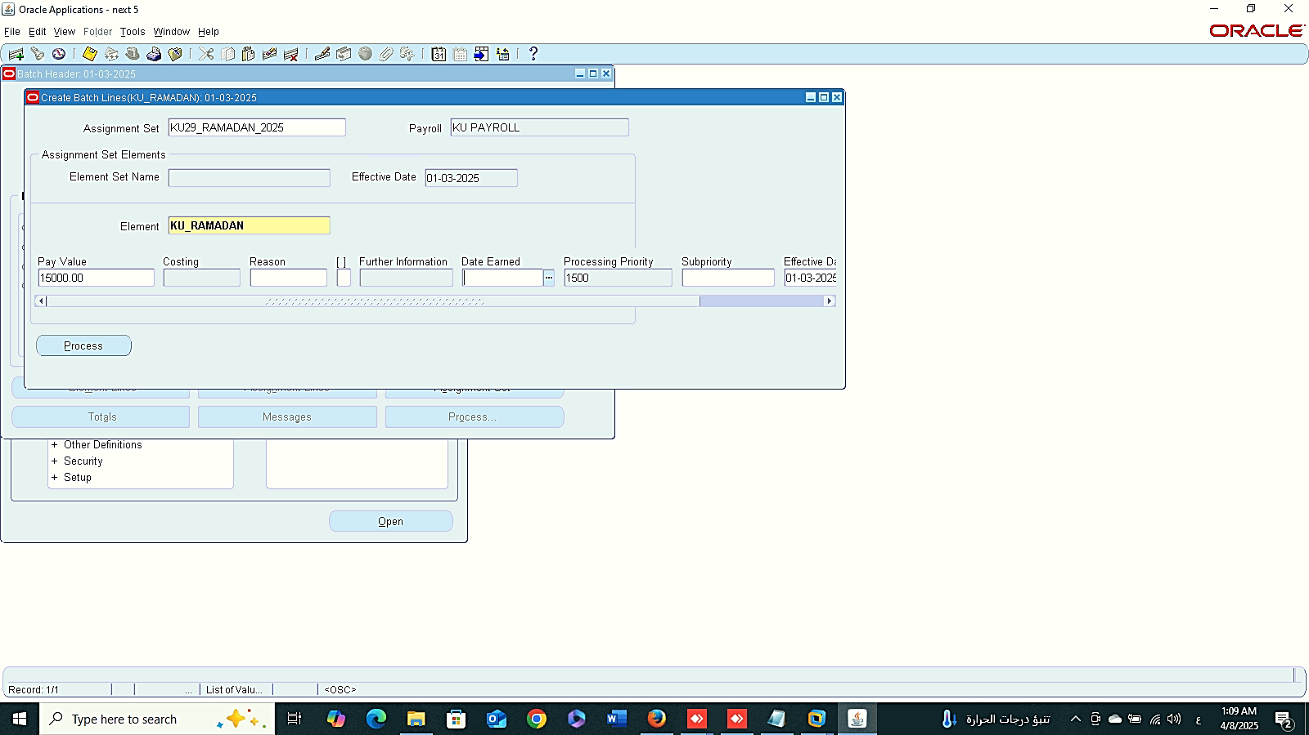
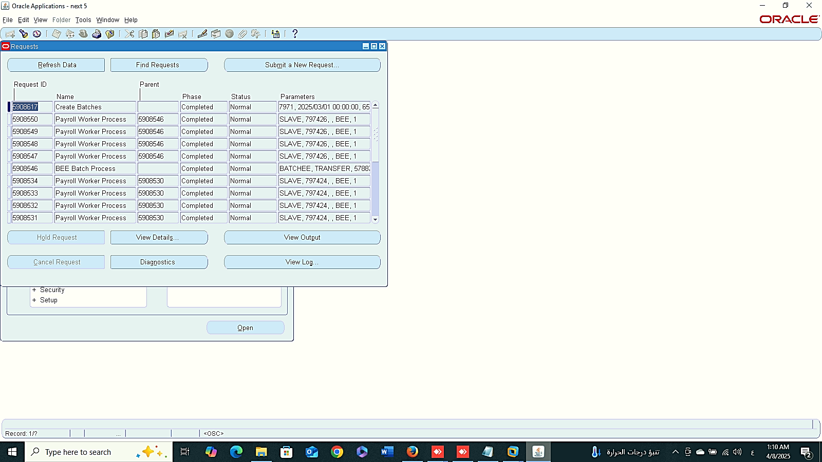

1
2
Finance Management (Payroll)
Assignment Set
4- Batch Element Entry (BBE)
GLOBAL HRMS MANAGER > MASS INFORMATION EXCHANGE MIX > BATCH ELEMENT ENTRY
3
4

Slide 14
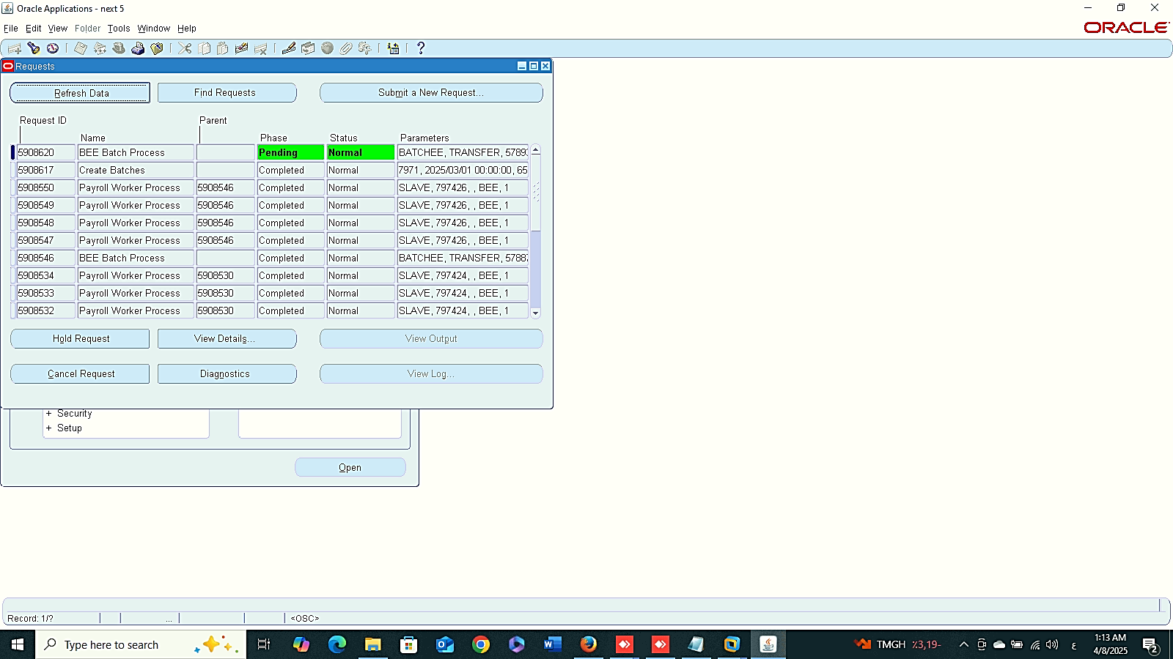
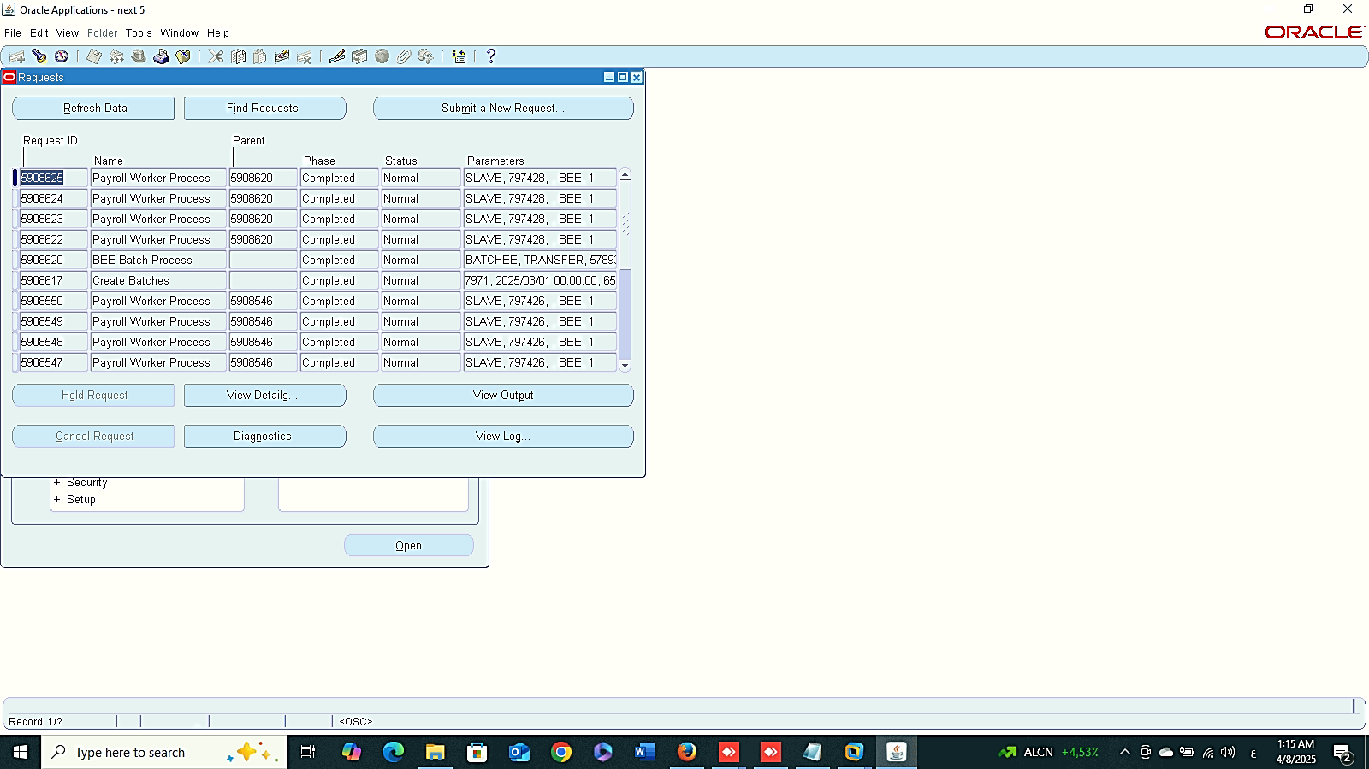

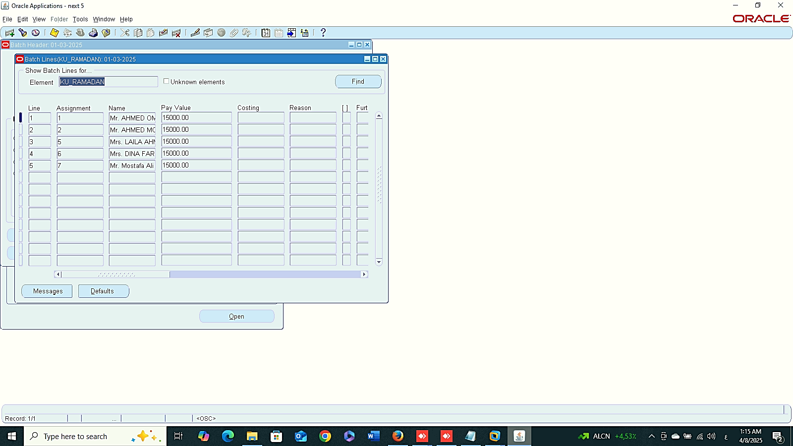
5
6
Finance Management (Payroll)
Assignment Set
4- Batch Element Entry (BBE)
GLOBAL HRMS MANAGER > MASS INFORMATION EXCHANGE MIX > BATCH ELEMENT ENTRY
7
8

Slide 15
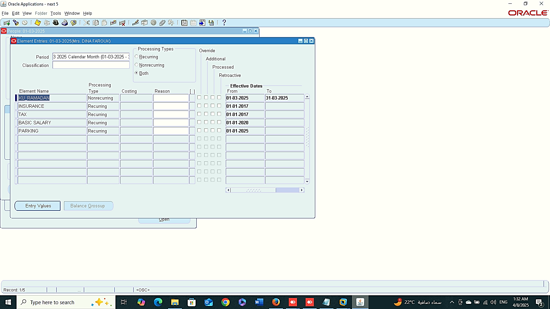


9
10
Finance Management (Payroll)
Assignment Set
4- Batch Element Entry (BBE)
GLOBAL HRMS MANAGER > MASS INFORMATION EXCHANGE MIX > BATCH ELEMENT ENTRY
11

Slide 16



Element Set
Finance Management (Payroll)
Element Set
GLOBAL HRMS MANAGER > PAYROLL > ELEMENT SET
Classification Rules
Classification Rules

